Slide 1
IMGA Board Meeting

Slide 3
Overview
Final Sports Program
Venue Selection
Budget
Marketing and Promotional Plans
Final Athlete Targets

Slide 4
Final Sports Program
Sports were selected based on:
Venue capacities and venue potential in Vancouver
Local organizing assets – Provincial Sport Organizations
Expected numbers of potential athletes

Slide 5
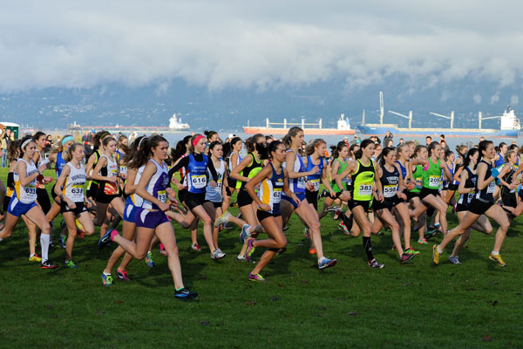
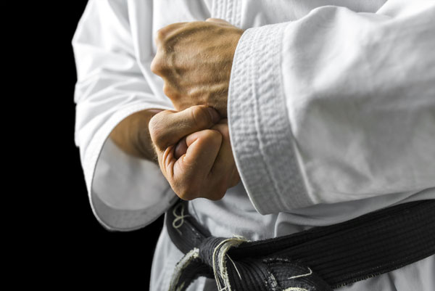
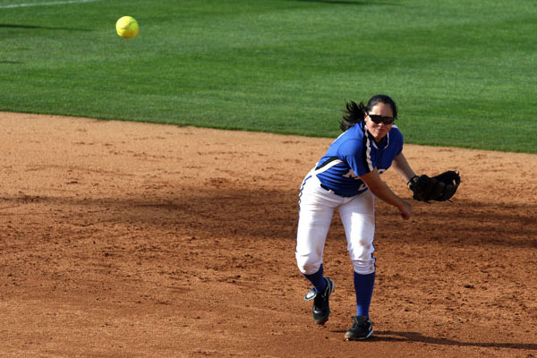
Final Sports Program – Alphabetical
Archery
Athletics
Badminton
Baseball
Basketball
Canoe Kayak
Curling Cycling
DanceSport
Diving
Field Hockey
Golf
Ice Hockey
Judo
Karate Lacrosse
Rowing
Rugby
Soccer
Softball
Squash
Swimming
Taekwondo
Table Tennis
Tennis
Triathlon
Volleyball

Slide 6
Venue Selection
One of the goals of the games is to create a fun and engaging multisport atmosphere
Keeping all sports in clusters allows for a better creation of atmosphere
We have selected 5 Key Venue Clusters to host a majority of Sports:
UBC
Vancouver Convention Centre
Hillcrest
Kitsilano
Stanley Park

Slide 7
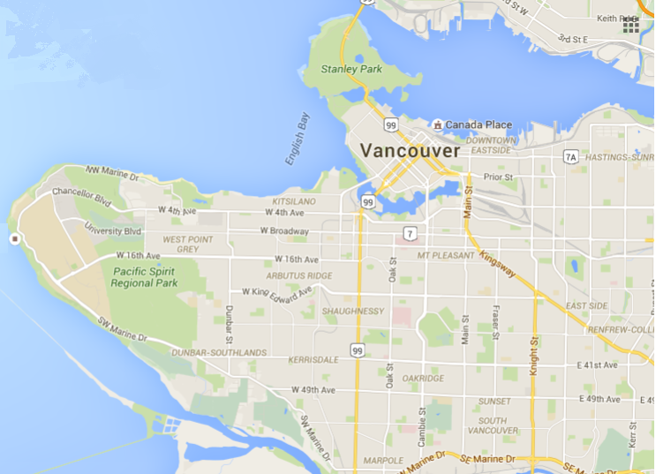
Venue Selection Map
5
UBC
Vancouver Convention Centre
Hillcrest
Kitsilano
Stanley Park
Scale –
Map Width is roughly
15 Kilometres
2
4
1
3

Slide 8
Budget
Revenues
Registration | 2,348,660
Partnerships | 1,349,333
Sponsorship | 500,000
Merchandising | 250,000
Government Funding | 500,000
Total Revenue | 4,947,993
Expenses
Operations | 2,616,845
Marketing and Communications | 633,330
Human Resources | 995,200
Finance and Corporate Services | 440,148
IMGA Rights Fee | 200,000
Total Expenses | 4,885,523
Net | 62,470

Slide 9
Marketing and Promotional Plans
Marketing Goals
Drive online registration
Maximize out of town athlete numbers
Marketing Strategies
Leverage Canadian sport partners and networks – direct communication
Digital ad space and communications – see Marketing Partners
Collateral at events where possible (postcards, pamphlets, etc)
Marketing Partners – (con’t next page)

Slide 10
Marketing and Promotional Plans
With the intention of aligning with an agency that can directly support AMG’s current digital marketing priorities, and do so in an efficient manner to best leverage our resources, the successful company will have outlined a focused approach to their expertise and support, and bring forth an international track record of success in this area.
Electronic direct marketing, social media, website optimization, Online Ad space
In conjunction with partner networks and existing IMGA database – digital newsletters to send to over 1,250,000 email accounts

Slide 11
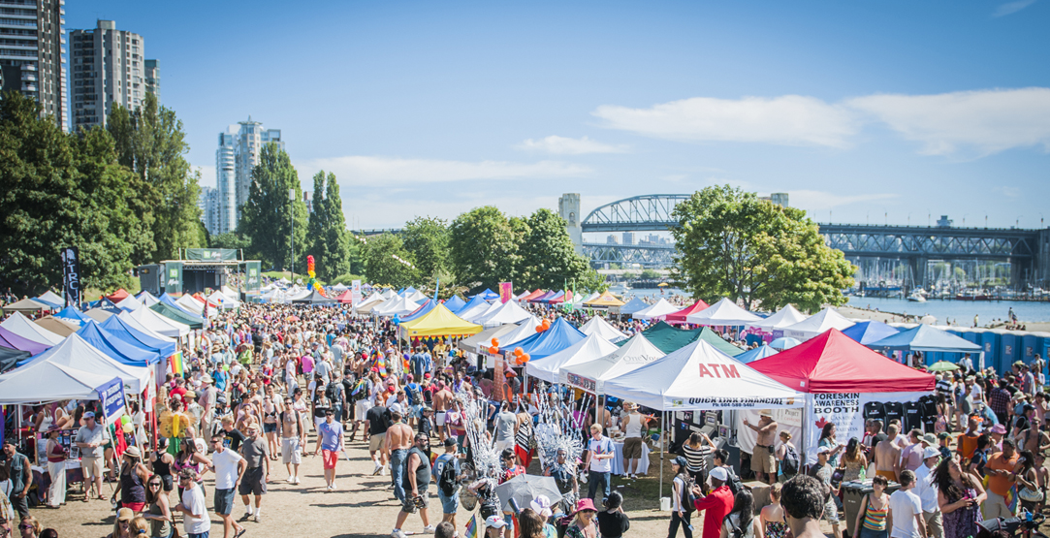
Final Athlete Targets
Target Number 10,000
By Sport:
Archery – 150
Athletics – 900
Badminton – 300
Baseball – 300
Basketball – 700
Canoe Kayak – 150
Curling – 400
Cycling – 200
DanceSport – 140
Field Hockey – 300
Diving - 100
Golf – 450
Ice Hockey – 1000
Lacrosse – 250
Judo – 150
Karate – 150
Rowing – 450
Rugby - 200
Soccer – 1000
Softball – 800
Squash – 120
Swimming – 600
Table Tennis – 300
Taekwondo - 100
Tennis – 300
Triathlon – 500
Volleyball – 700

Slide 12
End

