Slide 1
AMERICAS MASTERS GAMES 2016
SPORT ACCORD
Lausanne – April 17-22 2016
Copyright ® Americas Master Games 2015. All Rights Reserved.

Slide 3
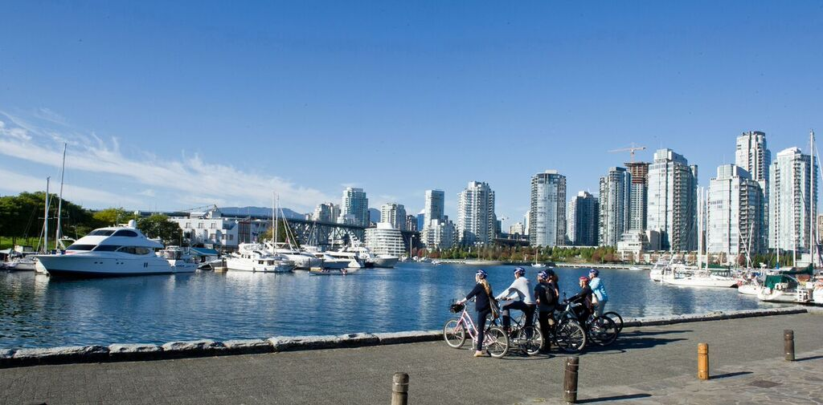
World renowned reputation for sport hosting
Ranked Vancouver 3rd most liveable City in the world Economist Intelligence Unit (2015)
One of Canada’s warmest cities
Beautiful cityscape and backdrop
Notes:
Please see Registrations by Type page - https://admin002.fusesport.com/private/memdb/customreports_display.asp?id=6759

Slide 4
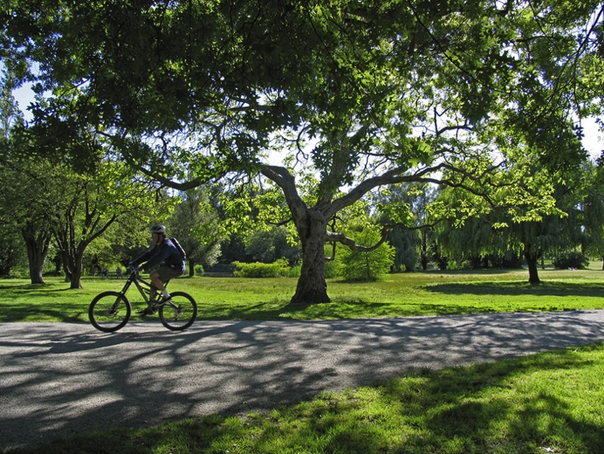
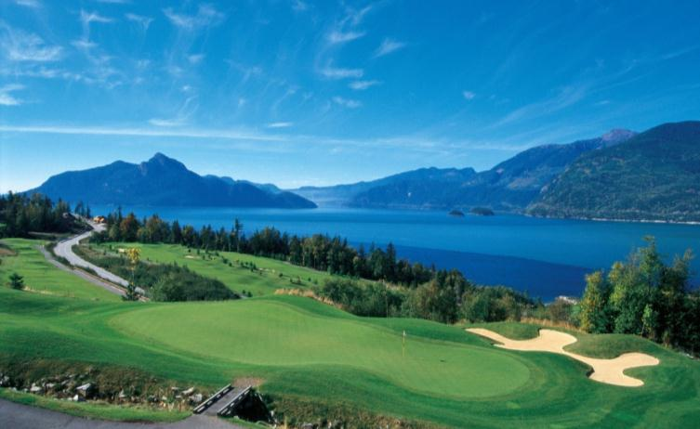
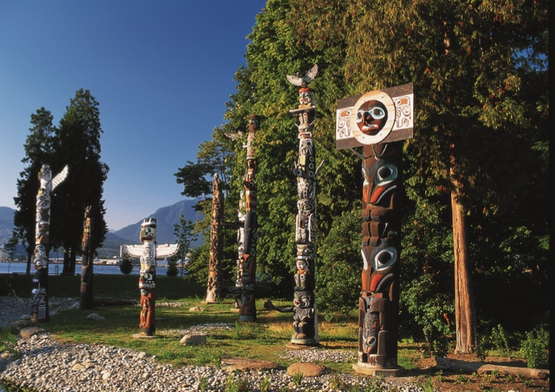
One of the worlds Greenest cities
Almost 300 different Parks, Gardens, and Scenic Beaches
Committed to sustainable living and events
Notes:
Please see Registrations by Type page - https://admin002.fusesport.com/private/memdb/customreports_display.asp?id=6759

Slide 5
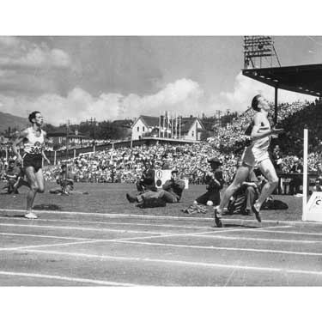
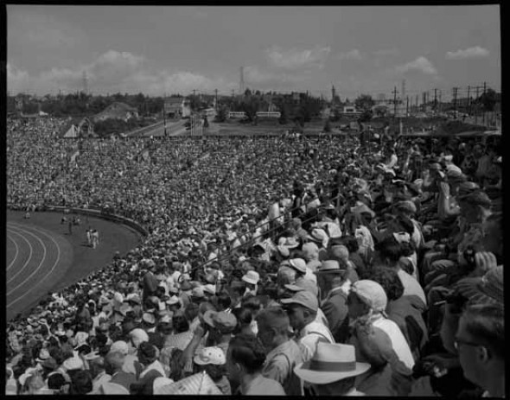
1954 British Empire and Common Wealth Games
Notes:
Please see Registrations by Type page - https://admin002.fusesport.com/private/memdb/customreports_display.asp?id=6759

Slide 6
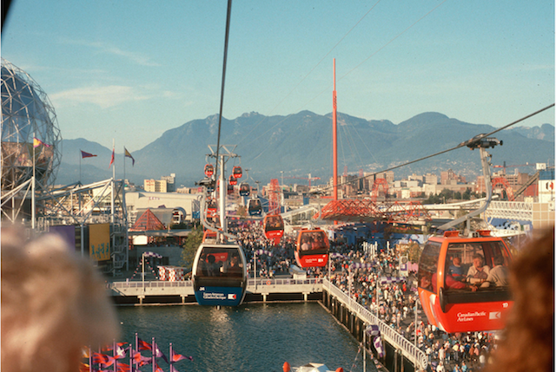
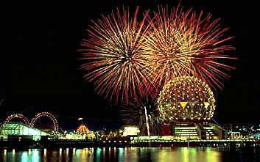
Expo 86 – World Fair
Notes:
Please see Registrations by Type page - https://admin002.fusesport.com/private/memdb/customreports_display.asp?id=6759

Slide 7
2009 World Police and Fire Games
Notes:
Please see Registrations by Type page - https://admin002.fusesport.com/private/memdb/customreports_display.asp?id=6759

Slide 8
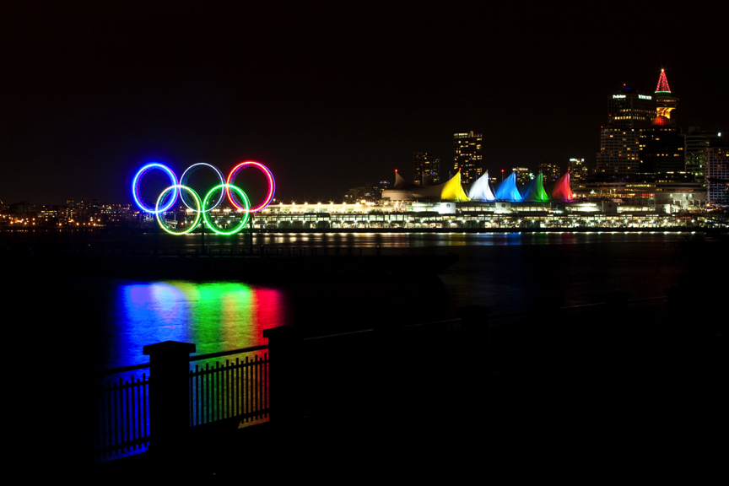
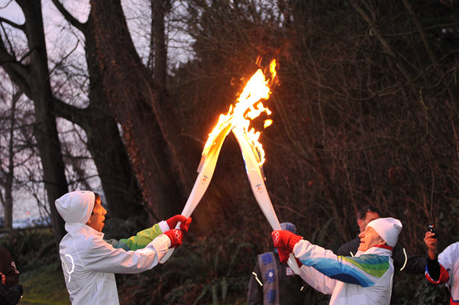
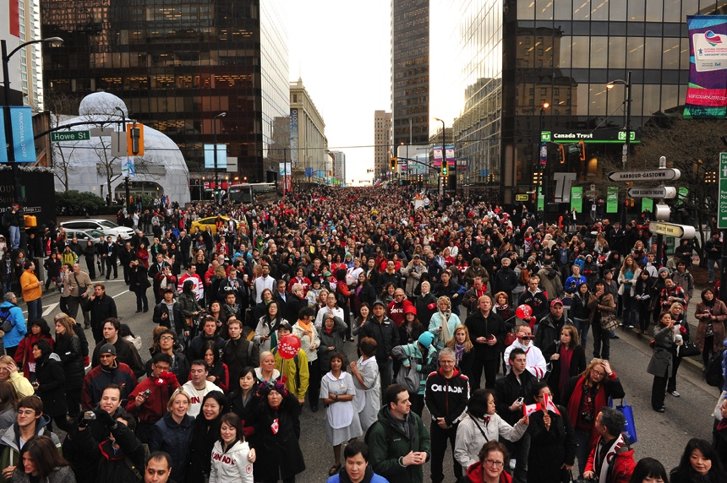
2010 Winter Olympic and Paralympic Games
Notes:
Please see Registrations by Type page - https://admin002.fusesport.com/private/memdb/customreports_display.asp?id=6759

Slide 9
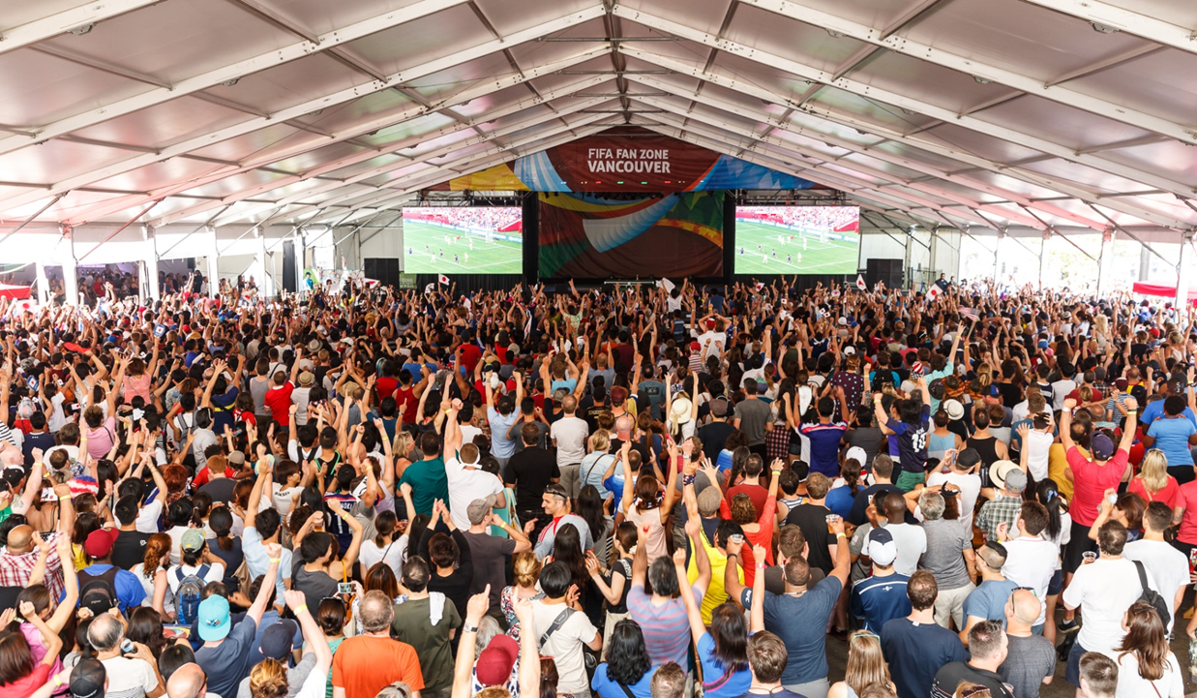
2015 FIFA Women’s World Cup
Notes:
Please see Registrations by Type page - https://admin002.fusesport.com/private/memdb/customreports_display.asp?id=6759

Slide 10
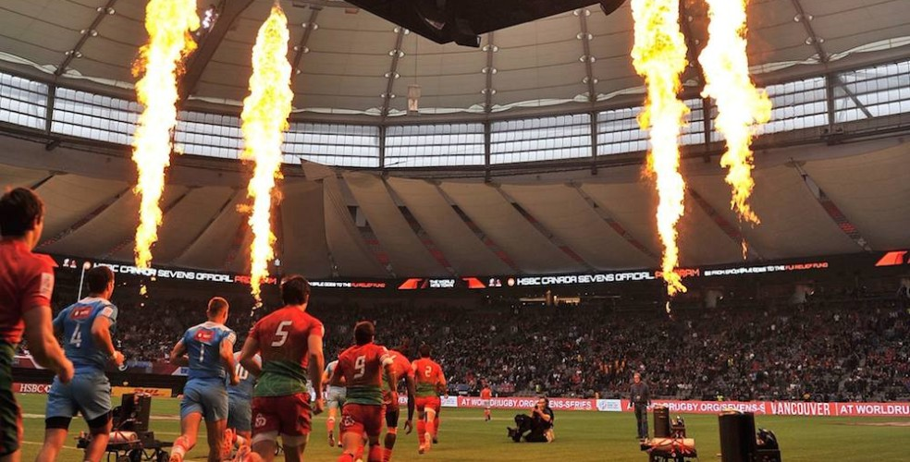
2016 HSBC Rugby 7’s World Sevens
Notes:
Please see Registrations by Type page - https://admin002.fusesport.com/private/memdb/customreports_display.asp?id=6759

Slide 11
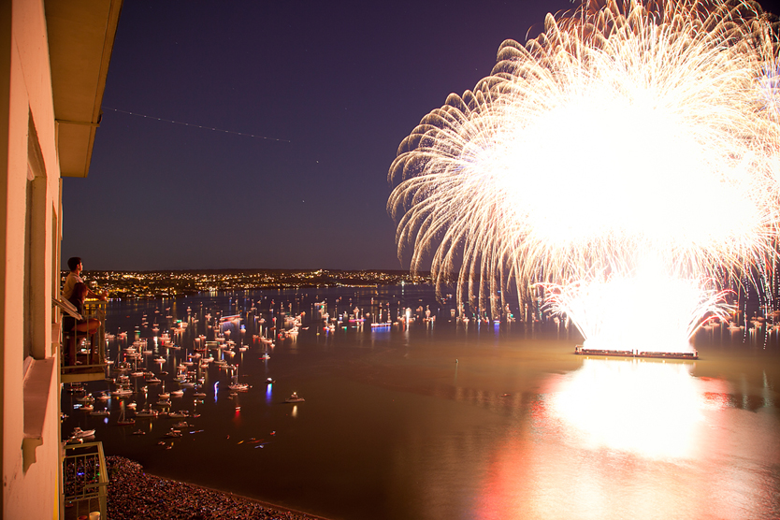
Successful Sport Hosting in Vancouver equates to
Sporting Event(s)
Venues
Accommodations
Tourist Activities
Notes:
Please see Registrations by Type page - https://admin002.fusesport.com/private/memdb/customreports_display.asp?id=6759

Slide 12
Sport Hosting Vancouver
Unique partnership model
Partnering Municipal Government with private enterprise and non-profit
Notes:
Please see Registrations by Type page - https://admin002.fusesport.com/private/memdb/customreports_display.asp?id=6759

Slide 13
Started in 1966 – Celebrating 50 years of sport excellence and development
Non-Profit Sport Federation
Representing 60 Member Sports
Notes:
Please see Registrations by Type page - https://admin002.fusesport.com/private/memdb/customreports_display.asp?id=6759

Slide 14
Host of the 2010 Winter Olympics
Historic Venues for AMG including Brockton Oval and Hillcrest
Notes:
Please see Registrations by Type page - https://admin002.fusesport.com/private/memdb/customreports_display.asp?id=6759

Slide 15
35 Member Hotels in Downtown Vancouver
Best rates and accommodations
15 Hotels within a 15 minute walk of Jack Poole Plaza
Notes:
Please see Registrations by Type page - https://admin002.fusesport.com/private/memdb/customreports_display.asp?id=6759

Slide 16
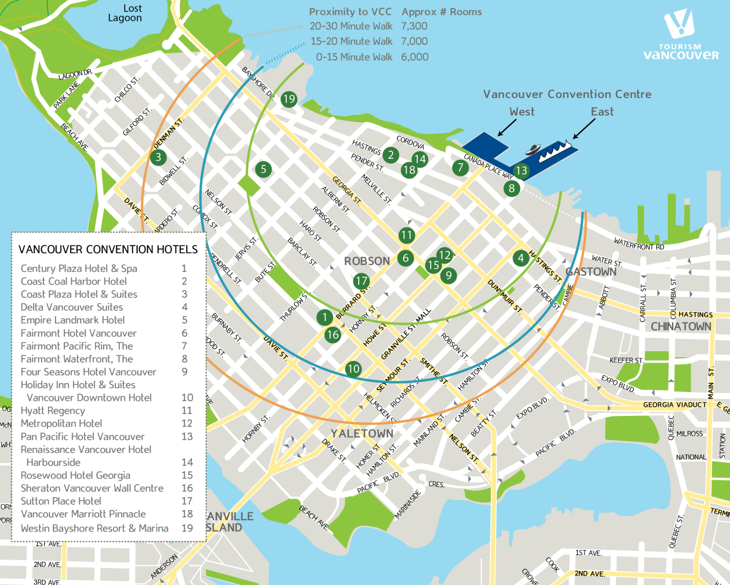

Slide 17
3 Major Cityscape Icons of Vancouver –
BC Place – Top 100 Football Stadiums
Vancouver Convention Centre East
Vancouver Convention Centre West
North Americas top destination for International Meetings (ICCA)
Notes:
Please see Registrations by Type page - https://admin002.fusesport.com/private/memdb/customreports_display.asp?id=6759

Slide 18
100th Anniversary this year
Consistently ranked a top 40 best university in the world
2010 Olympic and Paralympic Ice and Sledge Hockey Events
Davis Cup by BNP Paribas Men’s Tennis 2012 and 2013
Notes:
Please see Registrations by Type page - https://admin002.fusesport.com/private/memdb/customreports_display.asp?id=6759

Slide 19
Representing 1,000 members of tourism organizations to help the world experience Vancouver
Notes:
Please see Registrations by Type page - https://admin002.fusesport.com/private/memdb/customreports_display.asp?id=6759

Slide 20
Americas Masters Games – Overview
23 Selected Sports
Key Venues
Ceremonies
Next Steps
Notes:
Please see Registrations by Type page - https://admin002.fusesport.com/private/memdb/customreports_display.asp?id=6759

Slide 21
Sport | Competition Dates | Venue(s)
Archery | Aug 27 - Sep 1 | UBC
Athletics | Aug 28- Sep 2 | UBC and Area
Badminton | Aug 27 - Sep 3 | VCC West
Baseball | Aug 26 - Sep 1 | City Fields and UBC
Basketball | Aug 26 – Sep 2 | UBC and Kits Beach
Curling | Aug 27 - Sep 3 | Hillcrest
Cycling | Aug 27 – 29 | UBC and Cypress
Field Hockey | Aug 27 - Sep 2 | UBC and City
Golf | Sep 1 - Sep 3 | Langara, Fraserview, McCleery
Ice Hockey | Aug 28 - Sep 2 | City Rinks
Judo | Sep 1 - Sep 3 | VCC West
Notes:
Please see Registrations by Type page - https://admin002.fusesport.com/private/memdb/customreports_display.asp?id=6759

Slide 22
Sport | Competition Dates | Venue(s)
Karate | Sep 3 | VCC West
Lacrosse | Aug 27 - 31 | City Fields
Rowing | Aug 26 - 28 | False Creek
Rugby | Aug 29 - Sep 3 | Brockton (tbc)
Football (Soccer) | Aug 28 – Sep 3 | UBC and City Fields
Softball | Aug 26 - Sep 1 | City Fields
Squash | Aug 28 - Sep 4 | Private Clubs
Swimming | Aug 27 - Aug 30 | UBC
Table Tennis | Aug 28 - Sep 2 | VCC West
Tennis | Aug 26 - Sep 3 | Kits and Stanley Park
Triathlon | Sep 2 | Jericho
Volleyball | Aug 26 – Sep 4 | Spanish Banks and UBC
Notes:
Please see Registrations by Type page - https://admin002.fusesport.com/private/memdb/customreports_display.asp?id=6759

Slide 23
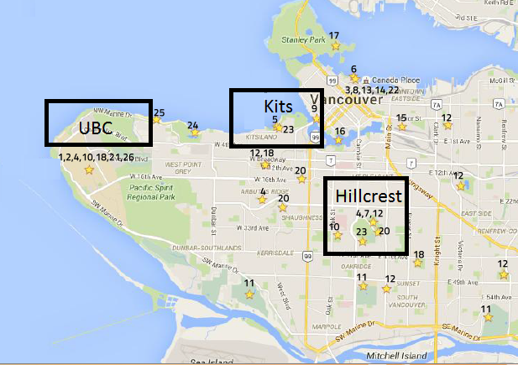
Key Venues
VCC
University of British Columbia
Hillcrest Community Centre
Kits Beach
Vancouver Convention Centre

Slide 24
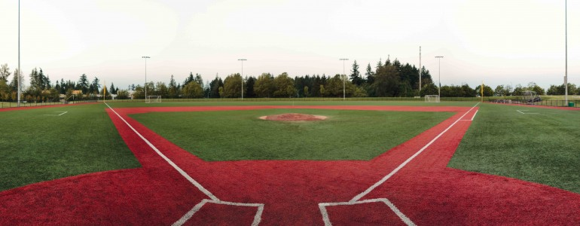
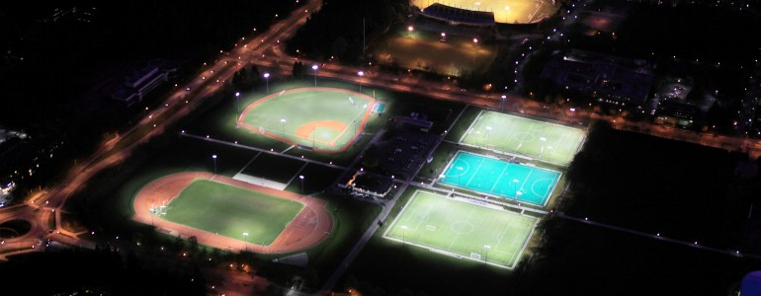
UBC – Hosting 10 Sports
Notes:
Please see Registrations by Type page - https://admin002.fusesport.com/private/memdb/customreports_display.asp?id=6759

Slide 25
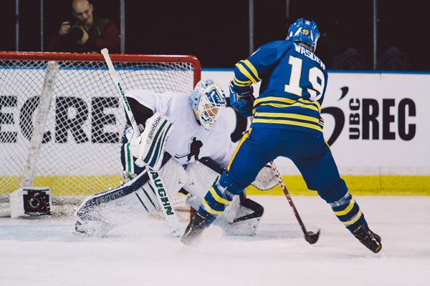
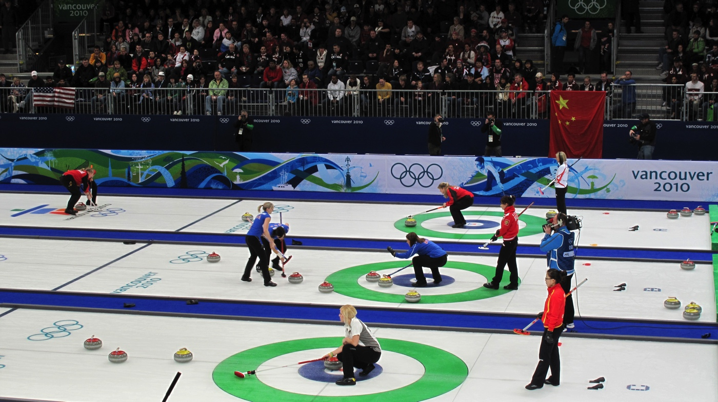
Hillcrest – 4 Sports
Notes:
Please see Registrations by Type page - https://admin002.fusesport.com/private/memdb/customreports_display.asp?id=6759

Slide 26
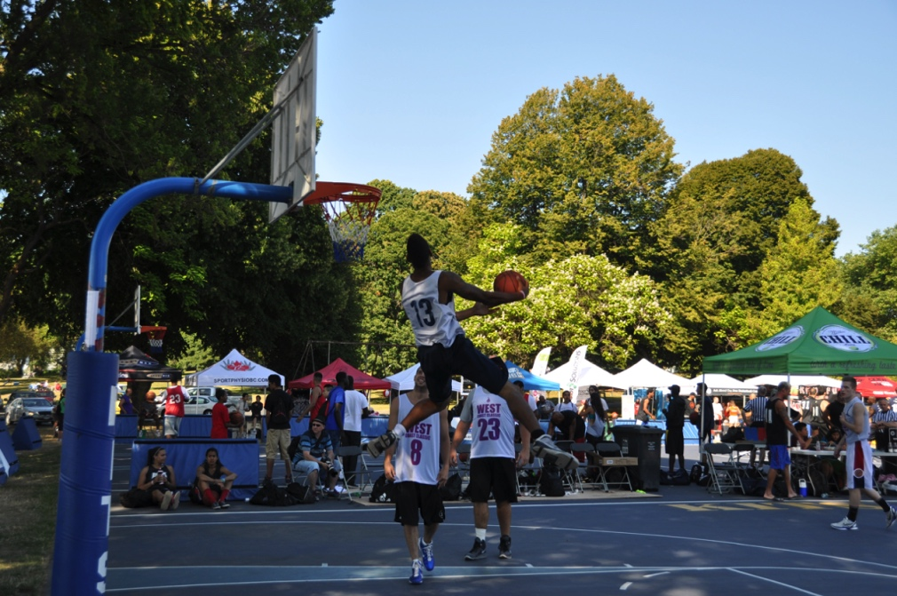
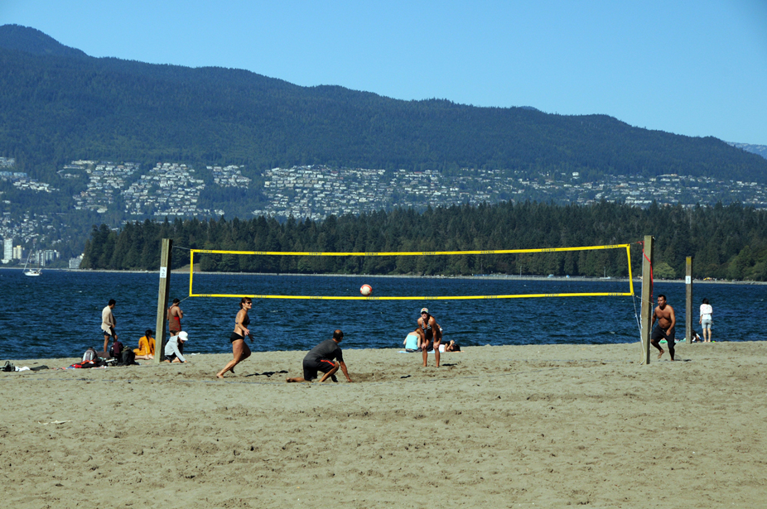
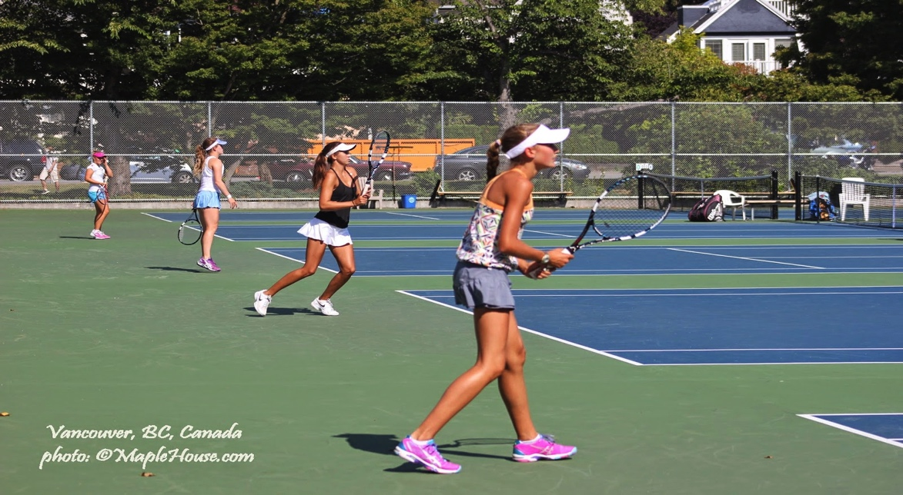
Kitsilano Beach - 3 Sports
Notes:
Please see Registrations by Type page - https://admin002.fusesport.com/private/memdb/customreports_display.asp?id=6759

Slide 27
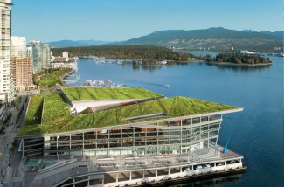
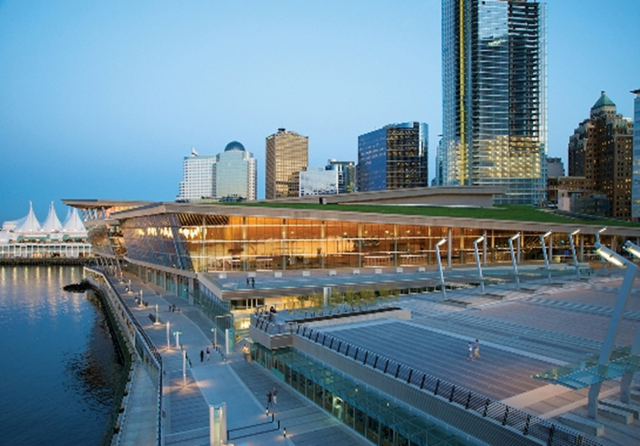
Vancouver Convention Centre (VCC) – 4 Sports
Notes:
Please see Registrations by Type page - https://admin002.fusesport.com/private/memdb/customreports_display.asp?id=6759

Slide 28
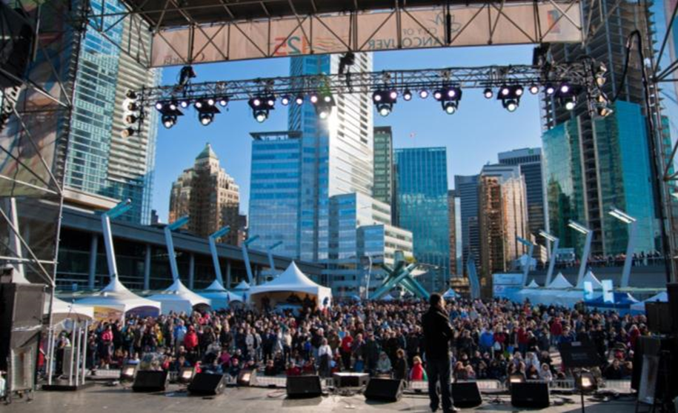
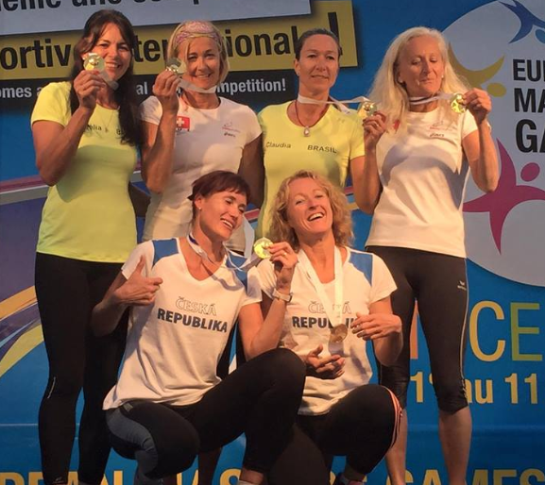
Jack Poole Plaza, VCC - Ceremonies and Nightly Events
Notes:
Please see Registrations by Type page - https://admin002.fusesport.com/private/memdb/customreports_display.asp?id=6759

Slide 29
Project to Date
Event operations underway
Sponsorship progressing
Comprehensive Medical Plan
Online registration growing – (numbers next page as of April 10)
Notes:
Please see Registrations by Type page - https://admin002.fusesport.com/private/memdb/customreports_display.asp?id=6759

Slide 30
Sport | Number
Archery | 36
Athletics | 172
Badminton | 41
Baseball | 10
Basketball | 73
Curling | 31
Cycling | 32
Field Hockey | 34
Golf | 63
Ice Hockey | 68
Judo | 5
Karate | 10
Sport | Number
Lacrosse | 4
Rowing | 19
Rubgy | 22
Soccer | 182
Softball | 17
Squash | 48
Swimming | 53
Table Tennis | 15
Tennis | 23
Triathlon | 45
Volleyball | 58
Lacrosse | 4
Rowing | 19
Notes:
Please see Registrations by Type page - https://admin002.fusesport.com/private/memdb/customreports_display.asp?id=6759

Slide 31
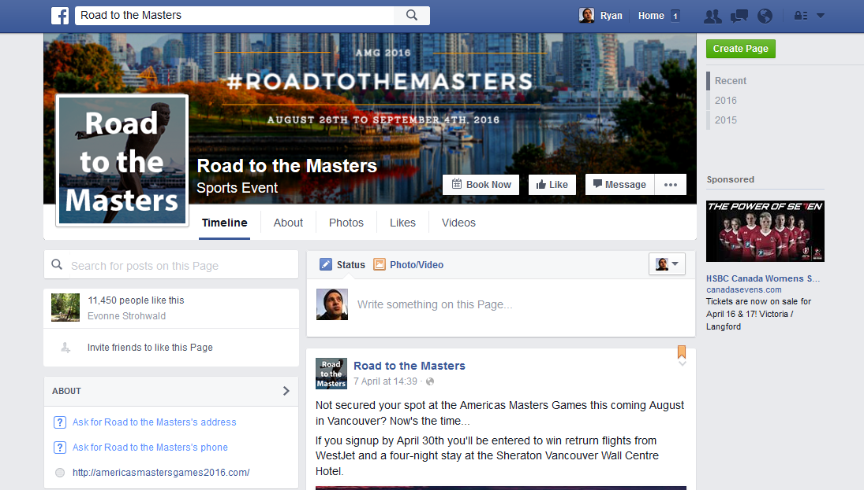
Project to Date - Marketing
11,450 people like this
Notes:
Please see Registrations by Type page - https://admin002.fusesport.com/private/memdb/customreports_display.asp?id=6759

Slide 32
Project to Date - Marketing
“The best part about my Masters experience was getting me through my cancer treatment with the goal of playing with my teammates again. The Masters provide a great incentive to keep active all year long.”
– Walter Janzen – Age 60 – Indoor Volleyball Masters Competitor
(Americas Masters Games Website)
Notes:
Please see Registrations by Type page - https://admin002.fusesport.com/private/memdb/customreports_display.asp?id=6759

Slide 33
Support moving forward
Targeted marketing through IMGA and its members
Notes:
Please see Registrations by Type page - https://admin002.fusesport.com/private/memdb/customreports_display.asp?id=6759

