Slide 1
EMG 2015 NICE
Cote D’Azur France

Slide 2
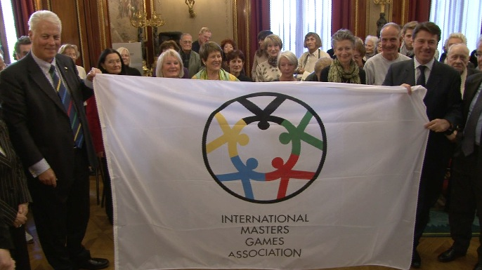
Milestones
Presentation to the Board in September 2011
Contract signed on the 12.12.11
CEO appointed by Nice in January 2012 (Schem DOUMA)
1st Operational meeting held in March 2012

Slide 3
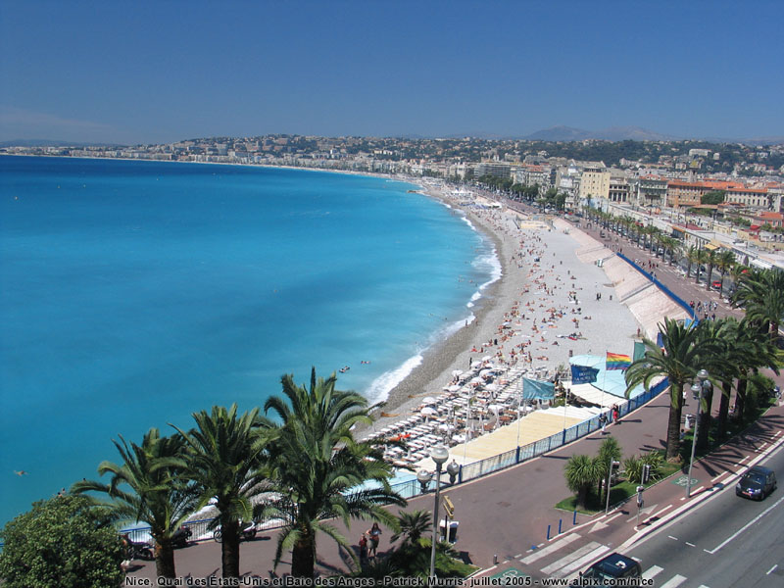
Why Nice
A city focused on sport, Tourism and promotion of a healthy lifestyle to an aging population
Well know city and famous tourist destination
Experienced sports department
Good Venues in central location

Slide 4
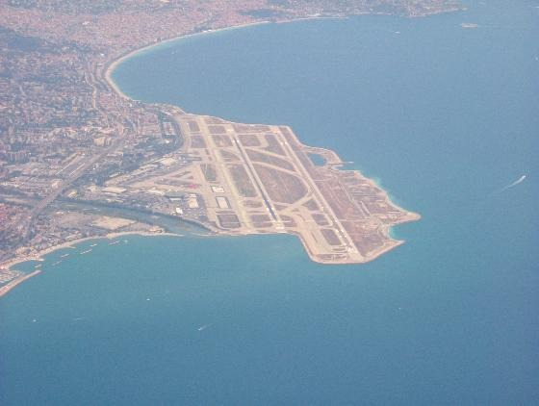
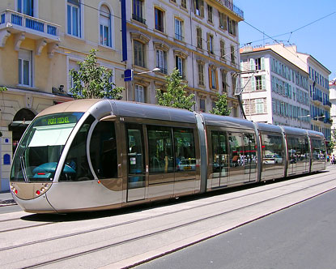
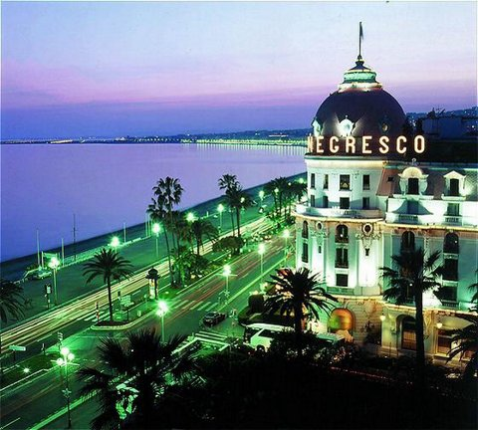
Accommodation & Transport
11000 Hotel rooms with majority in the 4-3* segment
2000 Holiday apartments
Large International Airport 15min from City center
Extensive public transport network (Free to Athletes)

Slide 5
Preliminary Sports Plan
Football - Rugby - Handball - Basketball - Beach-Volley - Field Hockey - Tennis - Table Tennis - Badminton - Softball - Athletics - Triathlon - Orienteering - Sailing - Rowing – Kayak - Taekwondo - Dance Sport - Cycling - Archery - Judo - Swimming – Petanque
Between September 10th - 20th 2015,

Slide 8
Questions Please

