Slide 1
Final Report EUROPEAN MASTERS GAMES NICE 2015 IMGA General Assembly Lausanne, Switzerland Monday 18th of April, 2015

Slide 2
1. Key Figures
2. Registrations on Sport and Nation
3. Finance
4. Video

Slide 3
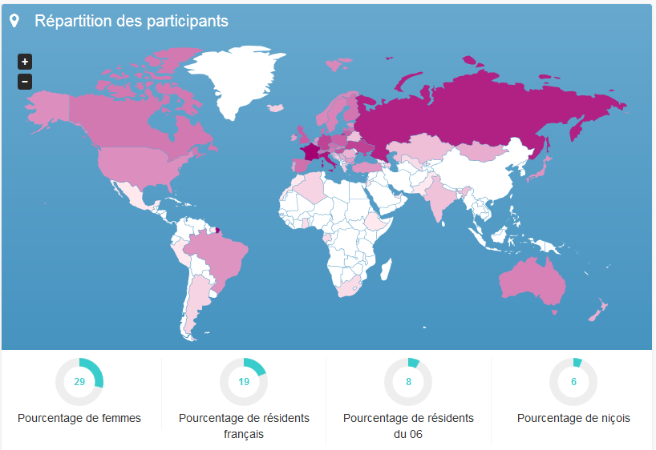
EUROPEAN MASTERS GAMES
Key Figures
7’261 athletes
798 acc. persons incl.
80 countries
Average age: 52
Youngest: 25
Oldest: 96 ans
1.14 sports on average
1.86 discipline on average
40 venues
27 sports
192 sporting events
1355 volunteers
29% women

Slide 4
EUROPEAN MASTERS GAMES
Registrations on Sport and Nation
Sports | Numbers
Handball | 736
Athletics | 504
Road Races | 470
Pétanque | 468
Dance Sport | 414
Swimming | 347
Football | 268
Karaté | 235
Basketball | 225
Archery | 199
Volleyball | 183
Taekwondo | 164
Judo | 144
Beach Volleyball | 144
Weightlifting | 138
Badminton | 117
Fencing | 107
Cycling | 98
Rugby | 97
Orienteering | 133
Open Water Swimming | 82
Rowing | 74
Tennis | 53
Table Tennis | 52
Squash | 46
Triathlon | 44
Sailing | 27
Sea Kayak Ocean Racing | 24
Countries | Nb of participants |  | Countries | Nb of participants
France | 1172 |  | Israel | 7
Italie | 637 |  | Inde | 5
Russie | 517 |  | Luxembourg | 5
Ukraine | 279 |  | Bosnie-Herzégovine | 4
Allemagne | 263 |  | Islande | 4
Hongrie | 183 |  | Grèce | 3
Lituanie | 153 |  | Algérie | 3
Royaume-Uni | 151 |  | Hong Kong | 3
Pologne | 149 |  | Argentine | 3
Danemark | 103 |  | Azerbaïdjan | 3
Tchèque, République | 99 |  | Polynésie Française | 2
Suisse | 95 |  | Ouzbekistan | 2
Espagne | 94 |  | Guyane Française | 2
Finlande | 87 |  | Trinite-Et-Tobago | 2
Lettonie | 86 |  | Liechtenstein | 2
Canada | 79 |  | Ghana | 2
Autriche | 77 |  | Gambie | 2
Australie | 62 |  | Afrique Du Sud | 2
Suede | 57 |  | Jamaique | 2
Slovaquie | 52 |  | Gabpn | 1
Norvege | 52 |  | Monténégro | 1
Etats Unis | 39 |  | Haiti | 1
Belgique | 39 |  | Emirats Arabes Unis | 1
Estonie | 36 |  | Pakistan | 1
Brésil | 36 |  | Barbade | 1
Japon | 35 |  | Géorgie | 1
Turquie | 33 |  | Nouvelle-Calédonie | 1
Pays-Bas | 31 |  | Perou | 1
Irlande | 28 |  | Saint-Marin | 1
Bulgarie | 27 |  | Macedoine, L'Ex-Republique Yougoslave De | 1
Portugal | 21 |  | Andorre | 1
Slovenie | 18 |  | Maroc | 1
Mongolie | 16 |  | Bahrein | 1
Nouvelle-Zelande | 14 |  | Gibraltar | 1
Serbie | 14 |  | Jordanie | 1
Roumanie | 12 |  | Mexique | 1
Monaco | 8 |  | Ethiopie | 1
Kazakhstan | 8 |  | Grenade | 1
Biélorussie | 7 |  | La Réunion | 1
Croatie | 7 |  | Moldavie, République De | 1

Slide 5
EUROPEAN MASTERS GAMES
Budget & Economic Impact
 | Items | Total
Expenses | IMGA Fee | 500 000.00
 | Paybox Fee | 2 278.76
 | Goodies | 137 168.56
 | Opening & Closing Ceremonies & Social Events | 176 465.32
 | Sports Equipment | 179 775.99
 | Protocol | 10 147.22
 | Security | 72 525.54
 | Grants | 314 250.00
 | Vacations | 19 049.40
 | Comm/Animations/Road Show | 950 295.96
 | Village/IT | 380 939.47
 | Health/Safety | 138 849.77
 | Transportation/Accommodation/Restoration | 197 116.20
Total Expenses |  | 3 078 862.19
Income | Conseil Général Funding | 150 000.00
 | Public Space Availability | 12 707.88
 | Registration Fees | 654 475.00
 | Transportation/Accommodation/Restoration | 6 105.60
Total Income |  | 823 288.48
City Investment : 2.25M EUR
Direct Tourisme Spending: 13,5M EUR
ROI : 6 Times

