Slide 2
EUROPEAN MASTERS GAMES
NICE 2015
GLOBAL ORGANIZATION PROGRESS REPORT
IMGA General Assembly – 7th April 2014
Antalya-Belek

Slide 3
MARKETING PLAN

Slide 4
MARKETING PLAN
I. THE PARTICIPANTS: AN AMBITIOUS AIM OF 10.000 ATHLETES
Tools:
IMGA’s data base and others (i.e.: national federations, works councils)
Tools: creation of an all-included package
Planning:
a “push” e-mailing campaign
Planning of presences on highly-targeted events (i.e.: world masters championships, “Road show”)
Indirect sales through Tour Operators on each area or specific field
Strategy of decreasing availability
Legacy: demonstration of Nice’s expertise on world sports events organization

Slide 5
MARKETING PLAN
II. THE REGIONAL AND LOCAL INVOLVEMENT
3 main aims:
Political involvement (including cultural, educative and health policies)
Economical involvement
Massive support of the population (recruitement of more than 1000 volunteers)
Tools
Communication through the city of Nice’s network (planning of presences; free media and others)
Local events (slogan contests, mascot, massive participation events: non stadia races, Iron-man, Nice’s Carnaval,…)
Creation of teams within the city of Nice (15 000 employees), works councils
HR plan within the city of Nice for internal skills development and participation (volunteers).
Legacy: all pushing for Nice

Slide 6
MARKETING PLAN
III. NICE’S RENOWN
2 main aims:
Rallying and involvement at the national level
International lobbying
Tools
Media
Communication campaign
Ambassadors program ( to date: 15 athletes or former athletes aggregating dozens of Olympic, World and European titles or medals… List of names will be communicated soon…)
Legacy: an outstanding city

Slide 7
MARKETING PLAN
IV. PARTNERS RECRUITMENT AND MERCHANDISING
2 main aims:
Private and public partners
Providers and sponsorships
Tools
Partners brochure and prospecting
Hospitality and observers’ programs
Village
Merchandising: incomes (goodies) and advertising tools
Legacy: a secure budget

Slide 8
WEBSITE & SOCIAL NETWORKS

Slide 9
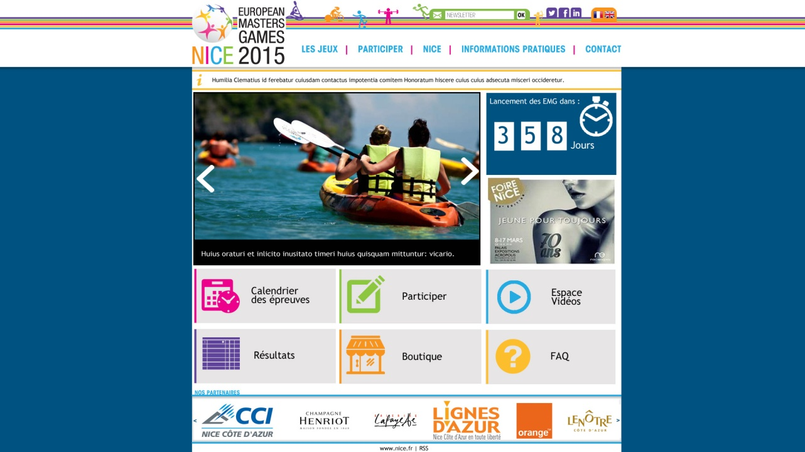
WEBSITE & SOCIAL NETWORKS
I. WEBSITE
www.emg-nice2015.fr
Launching date: 15th April 2014
Opening of registration: 1st October 2014
Languages: French/English
Homepage expected
(fictive sponsors)

Slide 10
WEBSITE & SOCIAL NETWORKS
II. EMG NICE 2015 ON SOCIAL NETWORKS
Facebook
Twitter
LinkedIn
Very soon…..

Slide 11
SPORTS PROGRAM

Slide 12
SPORTS PROGRAM
I. 27 SPORTS
Athletics
Archery
Badminton
Basket-ball
Beach Volley
Cycling
Fencing
Football (soccer)
Handball
Judo
Kayak (Ocean Racing)
Karate
Orienteering
Rowing (Coastal rowing)
Rugby
Sailing
Softball
Sport Dance
Squash
Swimming
Table Tennis
Taekwondo
Tennis
Triathlon
Volley-ball
Weightlifting
Wrestling
Petanque (demonstration event)

Slide 13
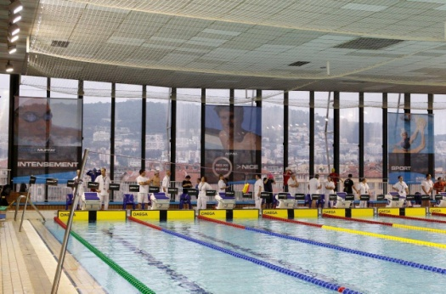
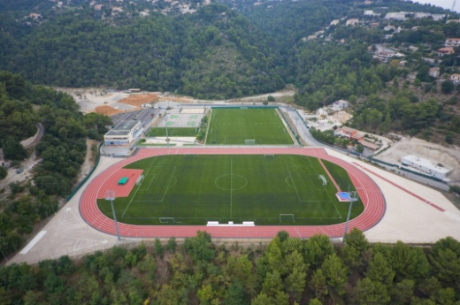
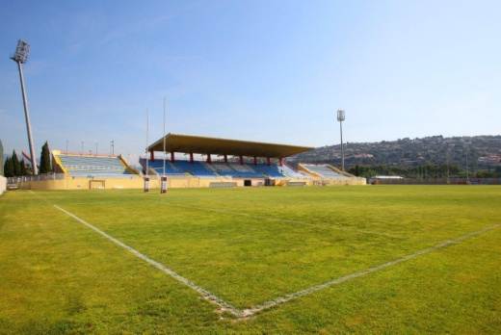
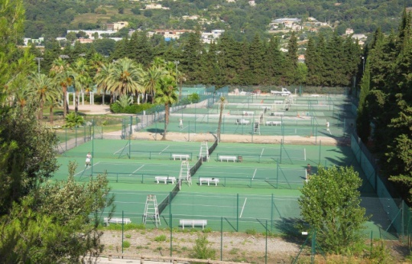
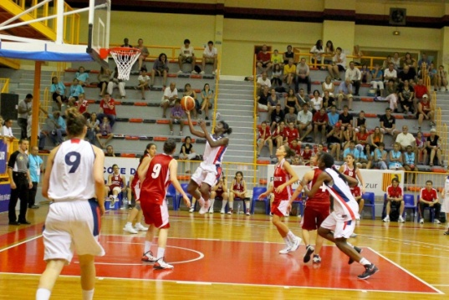
SPORTS PROGRAM
II. MORE THAN 40 VENUES…
Charles Ehrmann Sports Complex - Athletics
Jean Bouin Swimming Pool - Swimming
La Lauvette Complex – Football, Beach Volley
Arboras Sports Complex - Rugby
Tennis Club Les Combes - Tennis
Leyrit Gym – Basket-ball

Slide 14
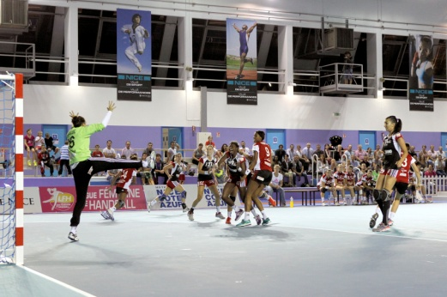
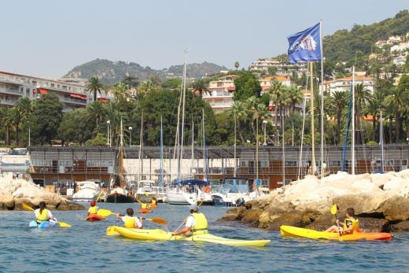
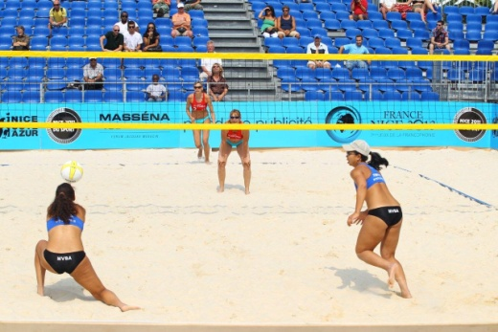
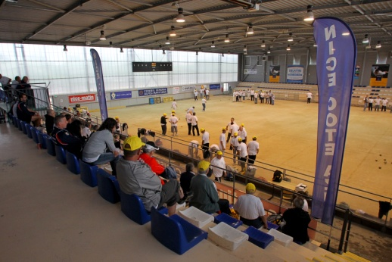
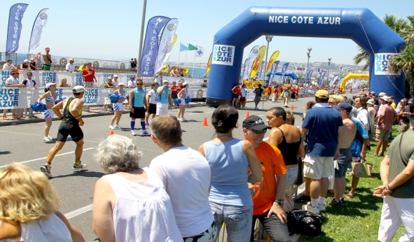
SPORTS PROGRAM
II. MORE THAN 40 VENUES…
Charles Ehrmann Sports Hall- Handball, Fencing
Nice Nautical Base – Sailing, Rowing, Kayak, Orienteering
Les Ponchettes Beach – Beach Volley
La Promenade des Anglais – Athletics (non stadia events), Cycling, Triathlon, Swimming (Open Water)
Henri Bernard Boulodrome – Petanque

Slide 15
We are really looking forward to seeing you in Nice in 2015…

