Slide 1
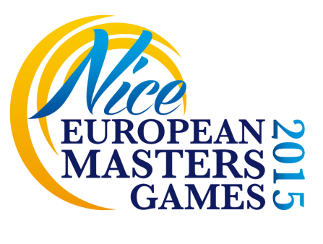
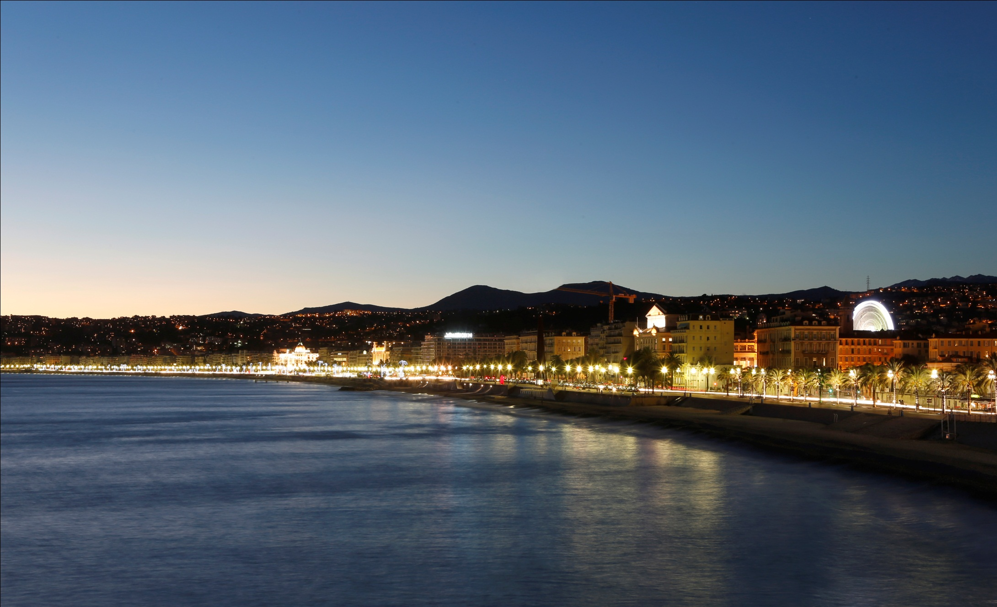
PRESENTATION
European Master Games
Nice 2015

Slide 2
Introduction
Presentation by Jean-Michel GALY,
City Councillor,
Deputy mayor in charge of Seniors

Slide 3
Summary
Nice’s delegation
Organising committee
Executive organisation chart
Sports programme
Venues presentation
Website

Slide 4
Nice’s delegation
in Turin
Mr. Jean-Michel GALY,
City Councillor,
Deputy mayor in charge of Seniors
Mr. Laurent CIUBINI,
Sports director of the city of Nice
Mr. Schem DOUMA,
EMG 2015 Project manager
Mr. Julien SASSI,
Manager of senior activities at the city of Nice
Mr. Julien ARNOLD,
Project manager at the city of Nice

Slide 5
Organising
committee
MAYOR OF NICE
EMG NICE 2015 OC President
Christian ESTROSI
Administrative Organisation
Mayor’s advisor in charge of high-performance sports events
Joël MIGLIORE
Sports director
Laurent CIUBINI
EMG 2015 Project manager
Schem DOUMA
Consulting Organ
Civil society and other public partners
Sports movement
CNOSF, CROS PACA, CDOS 06, local sports associations
Universities
University of Nice Sophia-Antipolis
Economic partners
CCI 06, UPE 06
Medical/Paramedical
CHU of Nice
Other public partners
Local, regional and national authorities, AAI (AFLD, HAS), ODT
Political organisation
City representatives
Deputy mayor in charge of Seniors
Jean-Michel GALY
Deputy mayor in charge of Sports
Deputy mayor in charge of Health
Deputy mayor in charge of Tourism
Deputy mayor in charge of Finances
Notes:
Political organisation: new city representatives will be appointed following the city’s elections in March 2014.

Slide 6
Executive organisation chart
Notes:
This organisation chart details the main branches and positions of the project. All the local authorities (city of Nice and Nice Côte d’Azur Metropolis) will be involved in the organisation. A project manager will be appointed for each sport.

Slide 7
Sports programme
Athletics
Archery
Badminton
Basketball
Beach volley
Cycling
Dance sport
Fencing
Football (soccer)
Handball
Judo
Karate
Kayak
Orienteering
Rowing
Softball
Squash
Swimming
Table tennis
Taekwondo
Tennis
Touch rugby
Triathlon
Weightlifting
Wrestling
FRENCH PETANQUE
Exhibition event -
free and open
to everyone !
Notes:
The sport of Pétanque was added to the programme because it is a typical and very popular activity in Nice. The competition will be free and open to all athletes and the public.

Slide 8
Venues presentation
All the venues below belong to the city of Nice
Final sports attribution for each venue will be adjusted depending on the number of participants
Local clubs will be designated in October 2013. Each club will be in charge of one discipline and will receive a grant from the city of Nice.

Slide 9
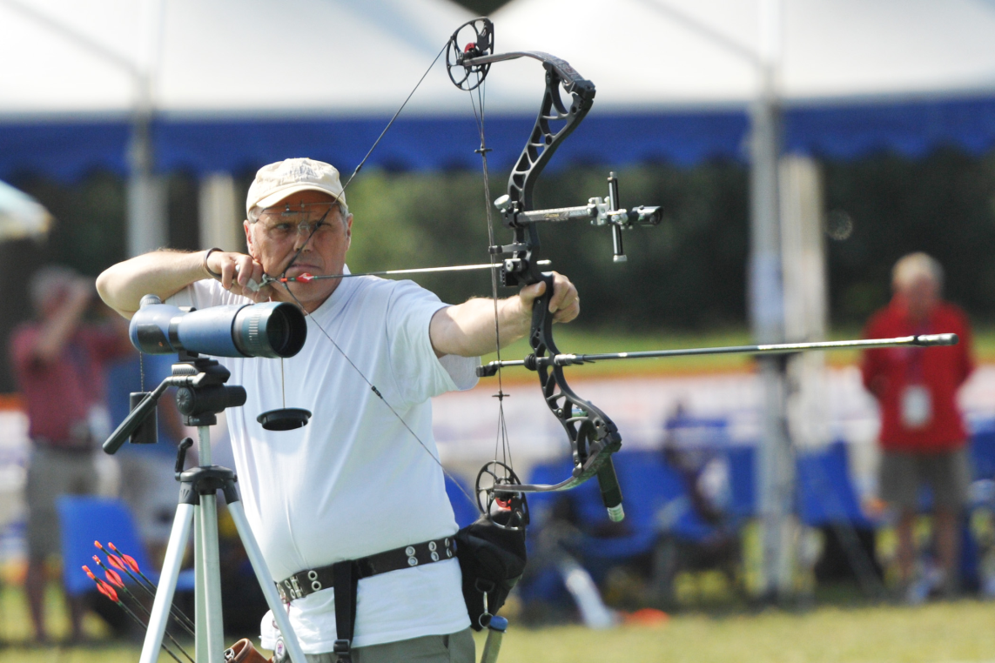
Archery
Francs Archers Archery Centre
Notes:
This facility is dedicated to archery competitions. The Francs Archers Company is the resident club there since 1977.

Slide 10
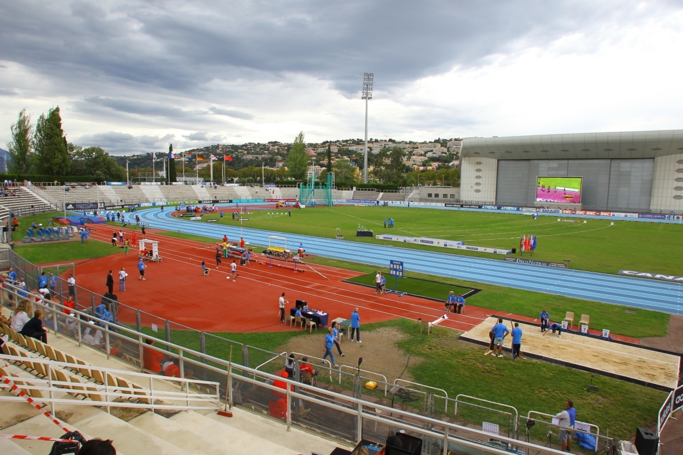
Athletics
Charles Ehrmann Sports Complex
Notes:
The stadium was just renovated this summer to host the athletics events of the Francophonie Games in September. It hosts lots of international competitions like the DecaNation in 2011.

Slide 11
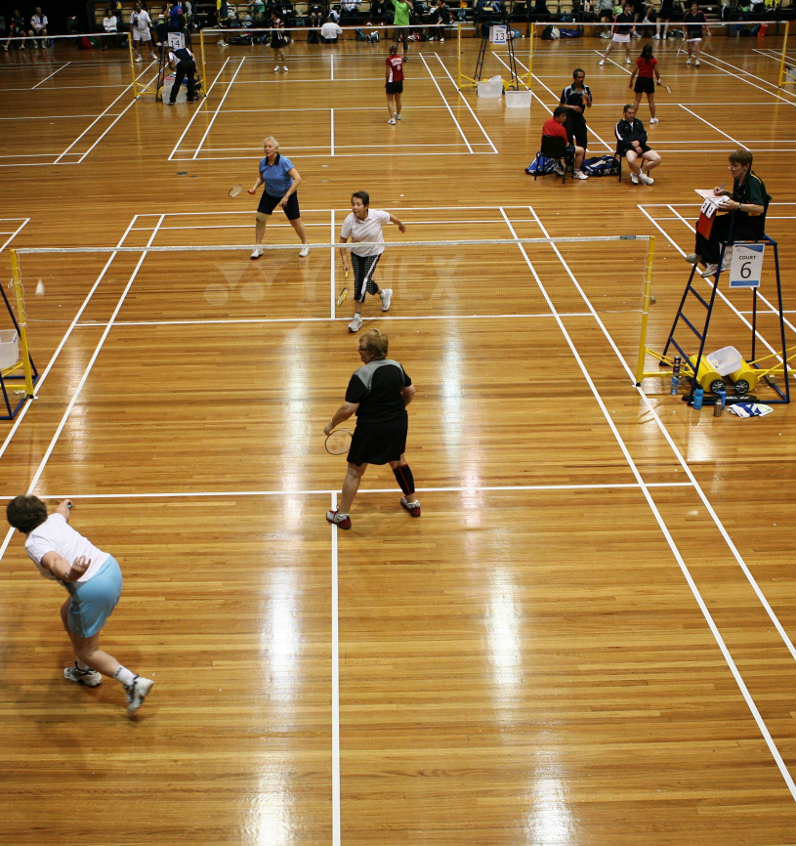
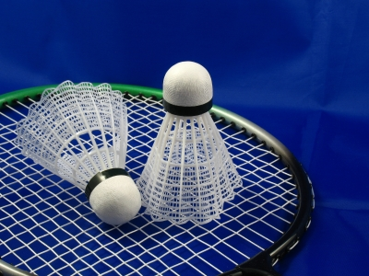
Badminton
Staps Gym
Notes:
The STAPS gym was built just last year. Two resident clubs train and play there. It hosts every year the Pluma Nissarda, an international badminton tournament in Nice.

Slide 12
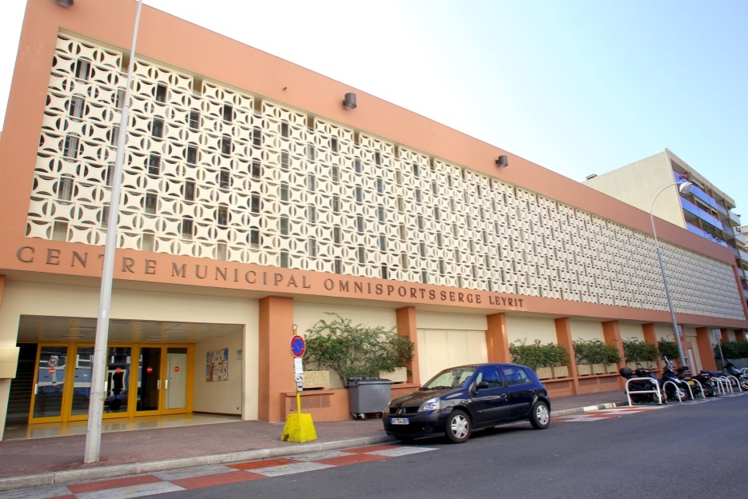
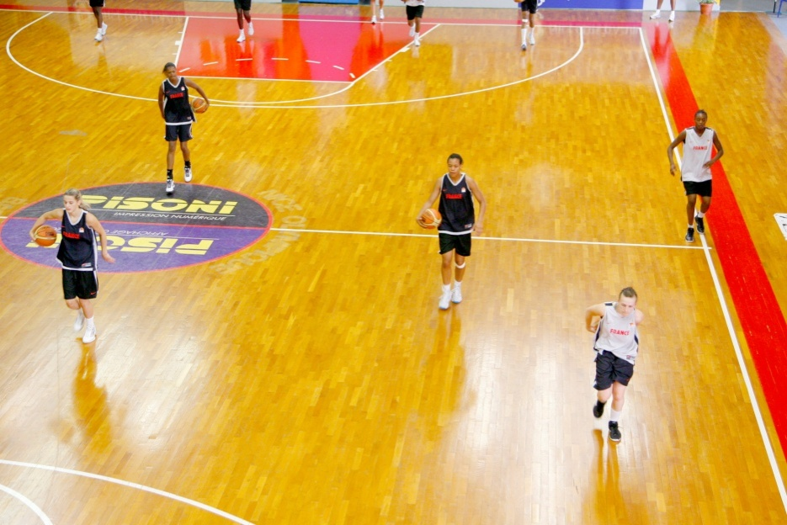
Basketball
Leyrit Gym
Notes:
Leyrit Gym was renovated last year and will host the basketball matches of the Francophonie Games in September. It is the home of the Cavigal women’s basketball team, which plays in the top division of the French championship.

Slide 13
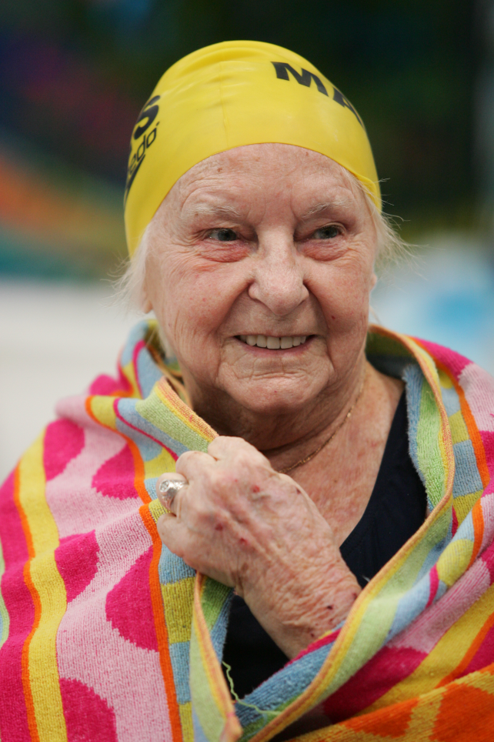
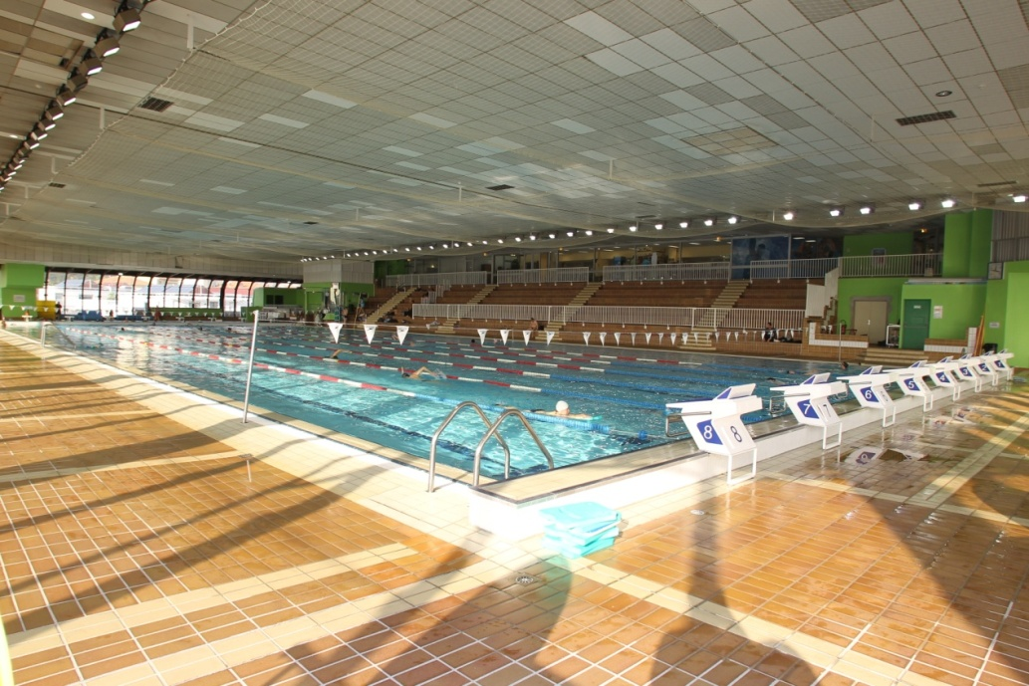
Swimming
Jean Bouin Aquatic Complex
Notes:
The Jean Bouin Aquatic Complex hosts the international swimming meeting of Nice every year. Many talented swimmers train there like olympic champions Yannick AGNEL and Camille MUFFAT, who are members of the resident club of Olympic Nice Natation.

Slide 14
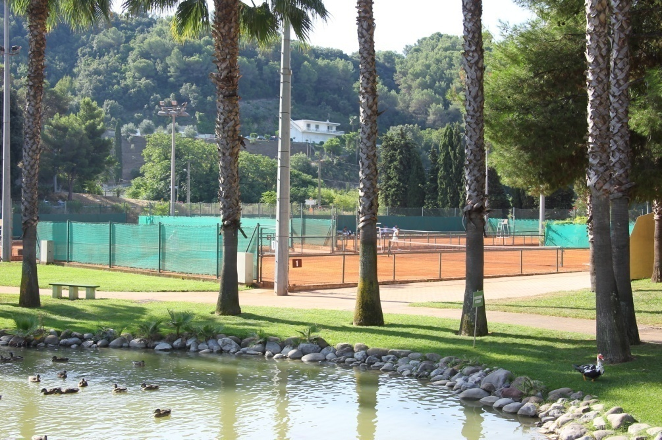
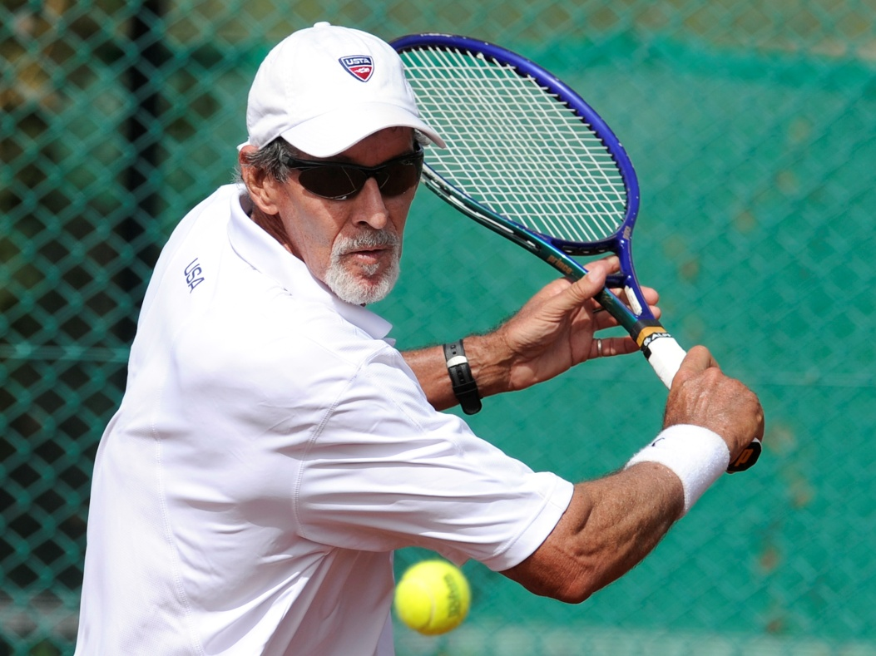
Tennis
Combes Tennis Centre
Notes:
The Combes Tennis Centre is located in an idyllic place right in the middle of nature. It was chosen by the French Federation of Tennis to become a national training centre in 2014. 11 new courts are about to be built in addition to the 17 current courts.

Slide 15
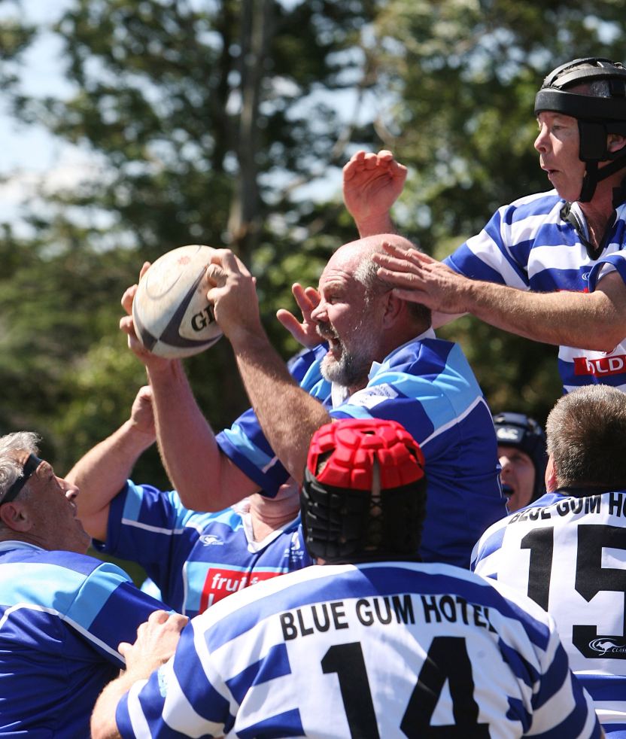
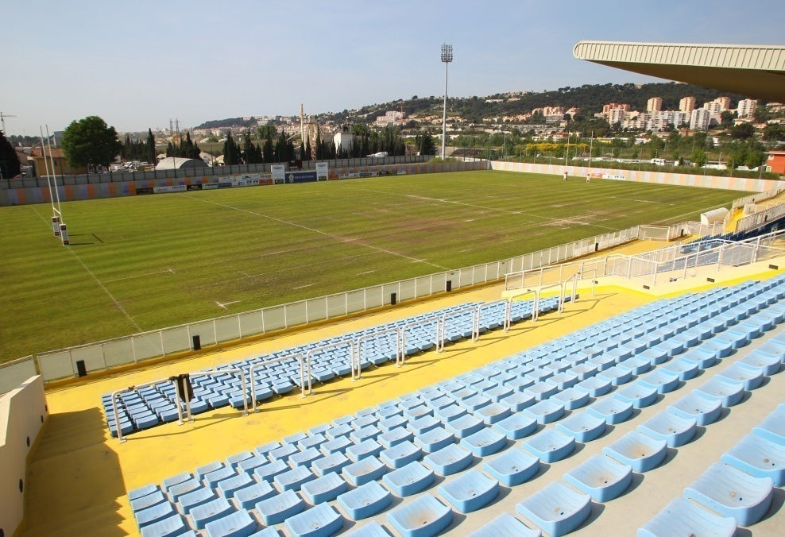
Touch Rugby
Arboras Sports Complex
Notes:
The Arboras Sports Complex is made of 3 rugby fields where the Stade Niçois trains and plays. Nice has a lot of ambition for its rugby team, which aims for a spot in the top division of the French championship in the next few years.

Slide 16
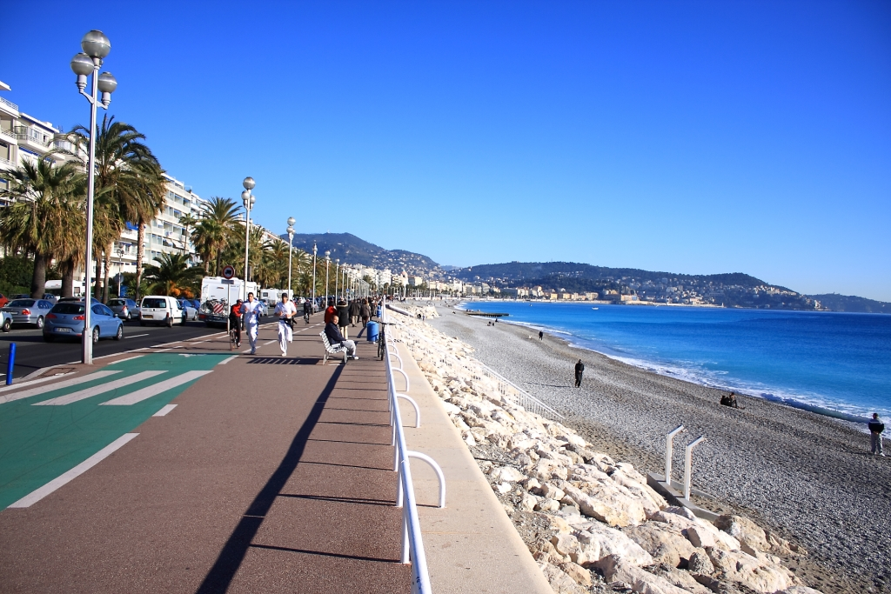
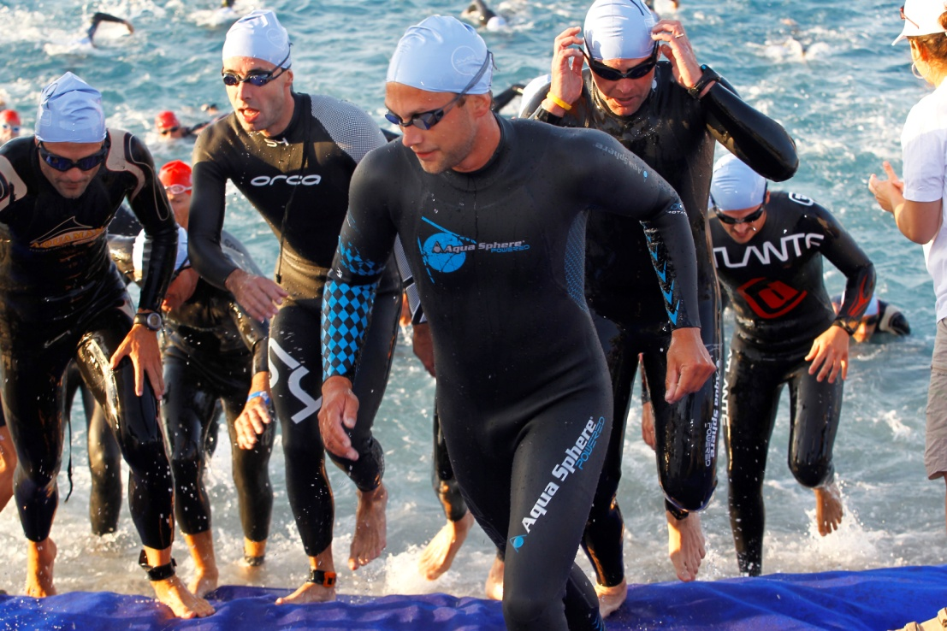
Triathlon
Promenade des Anglais & Nice’s Inland
Notes:
Nice has a great tradition of triathlon with the IronMan every year and the Nice Côte d’Azur Triathlon , which hosts the finals of the French championships since 2012.

Slide 17
Website
www.emg-nice2015.fr

