Slide 1
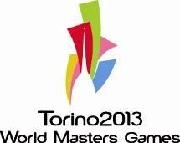


















IMGA Board
World Masters Games Torino 2013
LOC Presentation
Quebec 21 May, 2012
Paolo Bellino
Chief Operating Officer
WORLD MASTERS GAMES • TORINO 2013

Slide 2


Torino 2013 – Major Milestones achieved up to May 2012
April 2011: Appointment of the President of the OC > Mr. Fabrizio Benintendi
August 2011 : Full development of the www.torino2013.org website
February 2012: Partnership Agreement with Jumbo Grandi Eventi
March 2012: Meetings with all Sport Federations
April 2012 : Appointment of the Chief Executive Officer: Mr Cesare Vaciago
April 2012: Sport Program Definition
May 2012: Appointment of the Chief Operating Officer: Mr Paolo Bellino
May 2012 : Athletes Registration go -head

Slide 3



Torino 2013 – Sport Program
Core Sports
Optional Proposed Sports
Disabled sports
Archery
Athletics
Badminton (tbc)
Basketball
Cycling
Canoe-kayak
Soccer
Field Hockey
Rowing
Softball
Squash (tbc)
Swimming
Orienteering (tbc)
Weightlifting
Beach Volley
Bowls
Duathlon
Dance Sport (tbc)
Fencing
Golf
Rugby (tbc)
Sailing
Taekwondo
Tennis
Triathlon
Volleyball
Archery
Athletics
Tennis

Slide 4
Torino 2013 – Games Calendar

Slide 5
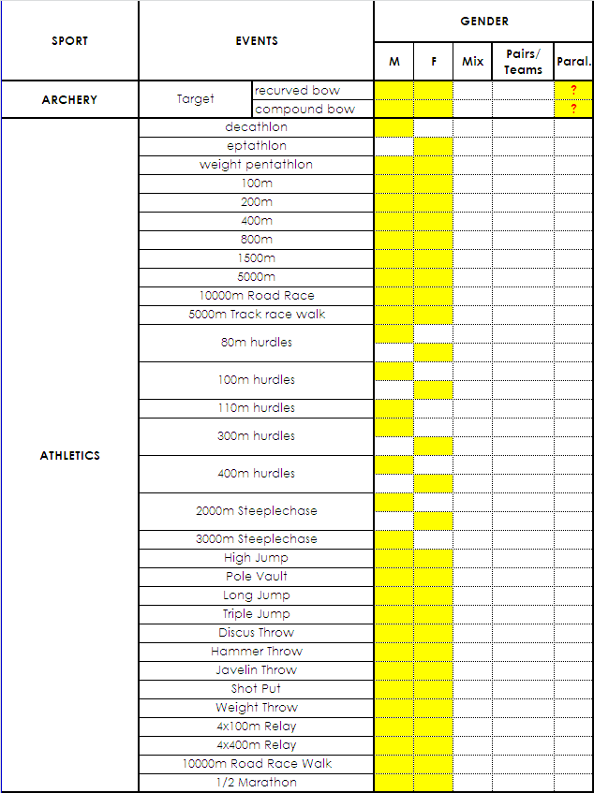
Torino 2013 Sport disciplines

Slide 6
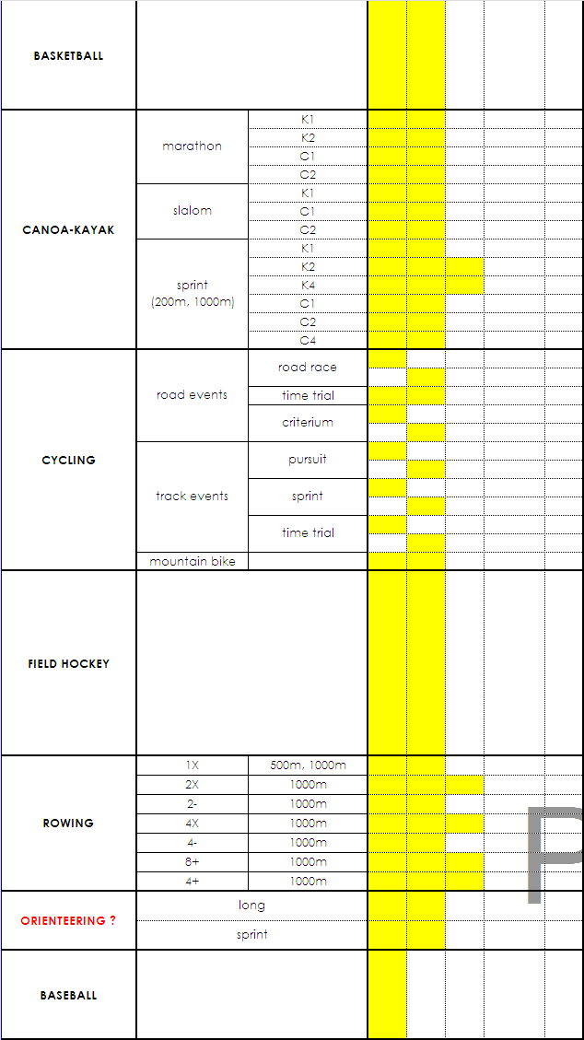
Torino 2013 Sport disciplines

Slide 7
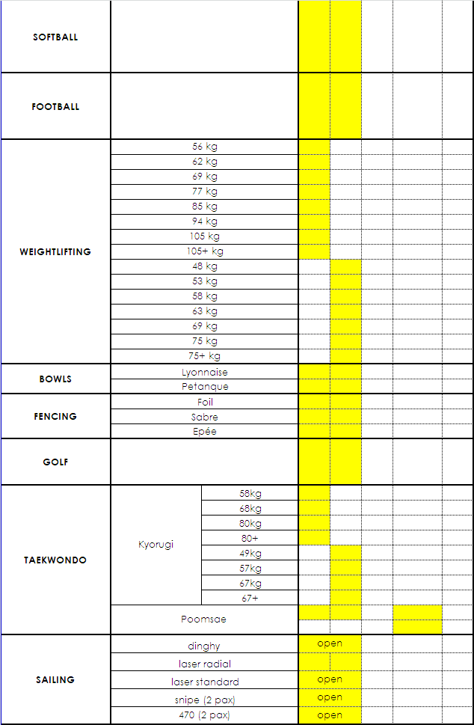
Torino 2013 Sport disciplines

Slide 8
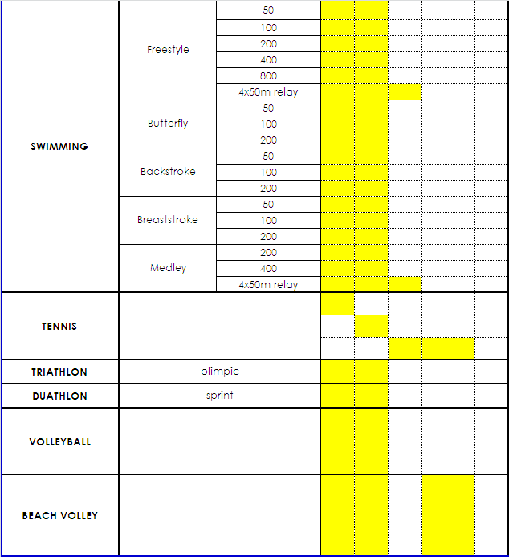
Torino 2013 Sport disciplines

Slide 9

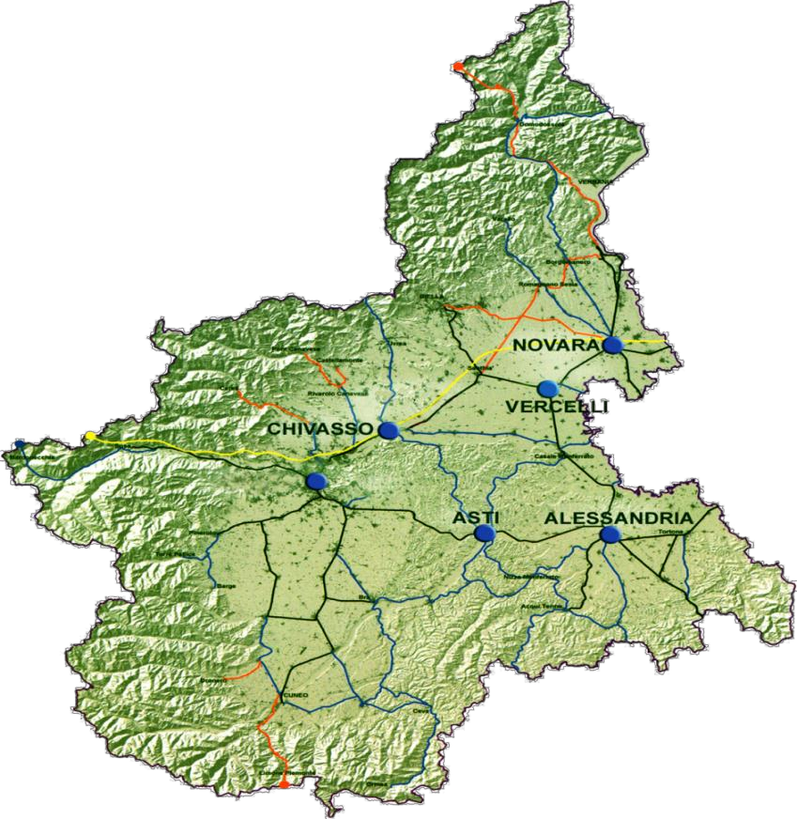
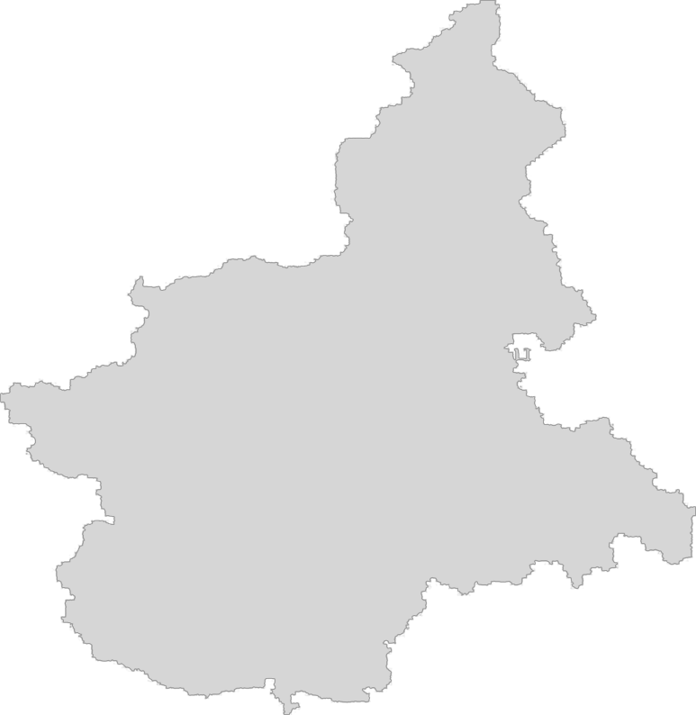



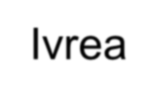




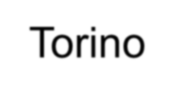
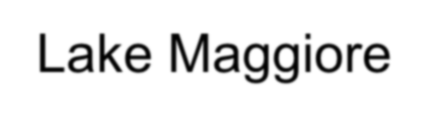




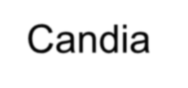







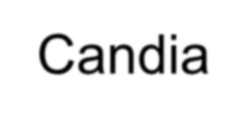








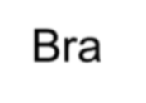

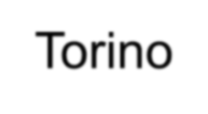





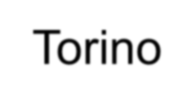






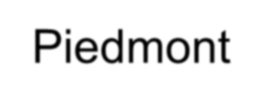







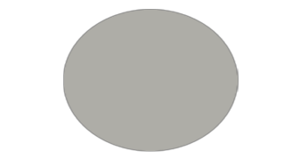
Torino 2013 - Venues Location
Ivrea – Torino
Candia
Canoe-kayak
Candia
Rowing
Verbania
Lake Maggiore
Sailing
Candia
Ivrea
Bra - Torino
Field Hockey
Torino
24 Sports
Disciplines
Torino
Bra
Piedmont
DISTANCES

Slide 10
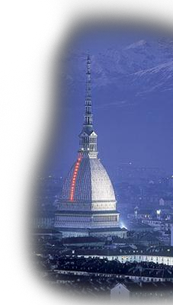
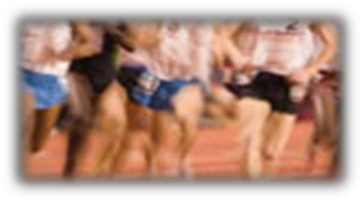
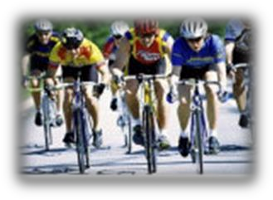
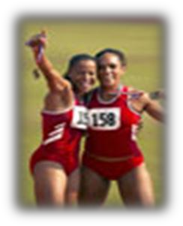
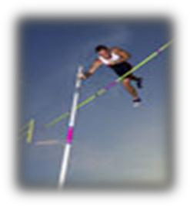
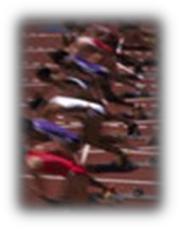
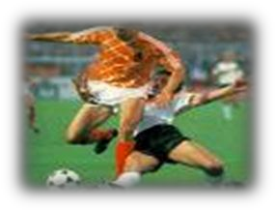
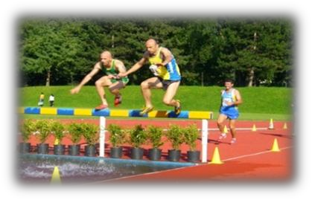
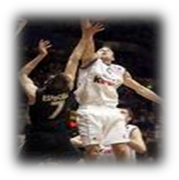
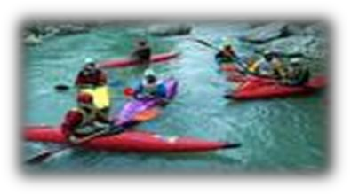
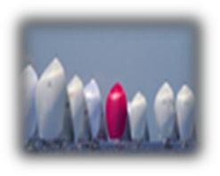
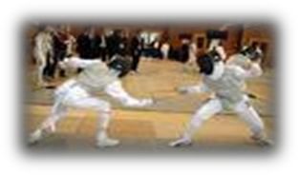
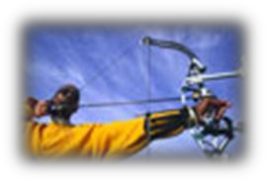
Torino 2013 – Website Visits – Mails - Registration
▪ 15 April - 15 May 2012
✓access > 12.379
pages visited > 58.136
1 January – 15 May 2012
  emails > 2100
14 May 2012 > Athletes Registration strart

Slide 11
Torino 2013 – WMG in numbers
Days of event: August, 2nd to 11th 2013
14 core sports
12 optional sports
3 disabled sports
20.000 athlets estimated
1.500 volounteers estimated
Games Budget of 7million Euros estimated
Games Center and Games Health /Lyfestyle Expo at To- Expo
Games Opening Ceremony in Torino on Saturday 3 August, 2013
Games Closing Ceremony in Torino on Sunday 11 August, 2013

Slide 12
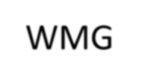
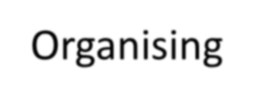

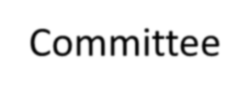




Torino 2013 – Organisational Model
WMG Organising Committee
Project Monitoring & Control
(Co-ordination role)
Jumbo Grandi Eventi
actual
planned
(Operating Services Provider)
Agreement 1
Agreement 2
Agreement 3
Organiser C
Organiser B
Contractor for for the organization of Golf
Organiser A
Contractor for
the organization of
Cy cling
Contractor for the orgnization of Athletics

Slide 13


Thank you for your attention
See you in Torino!

