Slide 1


IMGA General Assembly
WMG Torino 2013 Presentation
Saint Petersburg
27 May, 2013
Bernardino Chiavola
WMG Torino 2013 Chief Executive Officer

Slide 2



Agenda
Sport Program Participants
Organizational Structure
Games Centre Ceremonies Look of the City
IMGA Family Hospitality Broadcasting Volunteers
Benefits with Registration Games Budget
Sponsors
Timeline & Actions up to August 2013

Slide 3

Sport Program
Main Achievement
Sport Program finalised
Competition Schedules published on the web site All Italian Sport Federations involved
Technical Delegates appointed
Sport Clubs and Sport Associations committed to support the event Venues Location defined
Sport Guides under preparation and realised by end of May

Slide 4





























Sport Program
30 Sport > 165 Sport Disciplines
65 Sport Venues > 13 Municipalities involved
Sport
ARCHERY
ATHLETICS
BADMINTON
BASEBALL
BASKET
BEACHVOLLEY
BOWLS
CANOA4KAYAK
CICLING
Duathlon
FIELD HOCKEY
FOOTBALL
GOLF
JUDO
KARATE
ORIENTEREENG
ROWING
RUGBY
SAILING
SOFT BALL
SQUASH
SWIMMING
TAEKWONDO
TENNIS
TABLE TENNIS
S. PISTOL RIFLE S.CLAY TARGET
TRIATHLON
VOLLEYBALL
WEIGHTLIFTING

Slide 5
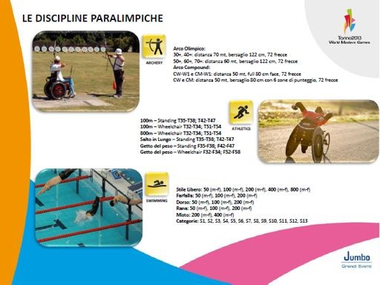

Paralympic Program
Sport Disciplines

Slide 6







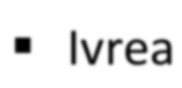






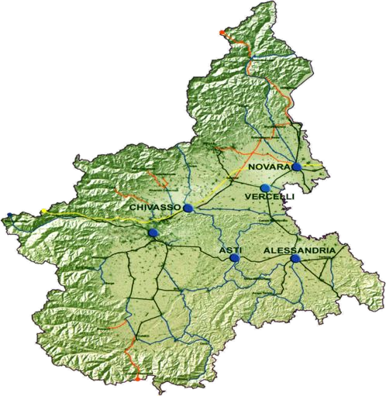














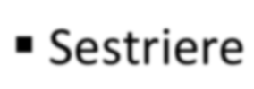






























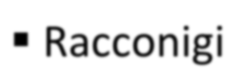






Sport Program
Venues Location
! Orta – S. Giulio
Sailing
Ivrea
Canoe9kayak
Candia
Canoe9kayak Rowing
Piemonte
Sestriere
Claviere,Cesana
Orienteering
! Bra 9 Torino
Field Hockey
Torino
Torino
La loggia
Robassomero
Fiano
Pinerolo
22 Sports Disciplines
! Racconigi
Shooting Clay Target
! Alba
Judo Karate

Slide 7

Participants
Core Sport
Sport | Athl | Arch | Bad | Bask | Cycl | Can kay | Field Hock | Socc | Row | Sho | SoM | Squ | Ori | Tab Ten | Wei
Athletes | 1014 | 153 | 187 | 750 | 350 | 251 | 280 | 1721 | 620 | 138 | 782 | 90 | 2716 | 95 | 337
Team Pers | 209 | 41 | 73 | 150 | 62 | 9 | 81 | 390 | 42 | 25 | 130 | 30 | 0 | 20 | 75
Total | 1223 | 194 | 260 | 900 | 422 | 260 | 361 | 2111 | 662 | 163 | 912 | 120 | 2716 | 115 | 412
Optional Sport
Sport | Bas | Bow | Bea Voll | Dua | Golf | Judo | Kara | Rug | Sail | Swi | Taek | Ten | Tria | Voll
Athletes | 32 | 17 | 254 | 97 | 242 | 20 | 32 | 120 | 6 | 556 | 39 | 103 | 149 | 780
Team Pers | 1 | 0 | 45 | 10 | 10 | 0 | 1 | 35 | 0 | 93 | 6 | 8 | 12 | 98
Total | 33 | 17 | 299 | 107 | 252 | 20 | 33 | 155 | 6 | 649 | 45 | 111 | 161 | 878

Slide 8

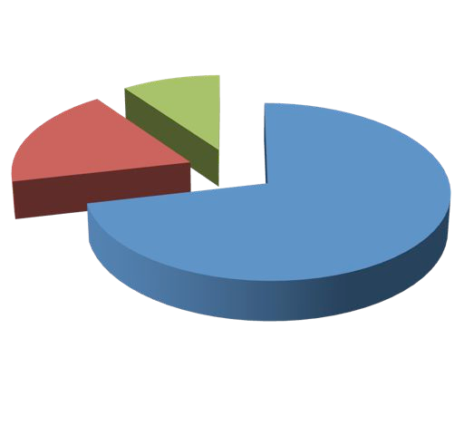
Participants
Personel
Athletes and
Accompanying Person Registered so far
1656
Athletes
3122
Registered Accompanyng Personell
Registered Team Personell
11931

Slide 9

Participants
Countries
Countries represented in the WMG Torino 2013
%
30,0
25,0
20,0
15,0
10,0
5,0
0,0
%
Canada
Others
Usa
Italy
Brazil
Australia
Germany
SouthAfrica
Switzerland
Russian Fed.
New Zealand
United Kindon

Slide 10




















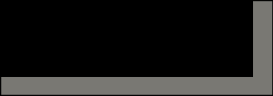






CO Organisational Structure
President Organising CommiYee
F. Benintendi
Torino 2013 WMG Association
Executive CommiYee
Organising Committee :
F. Benintendi
IMGA: G. Gola
Piedmont Region: A. Cirio
President: F. Benintendi
•Vice President (G.Ferrari)
•Councillor 1 : B. Chiavola
•Councillor 2 : A. Colarelli
Vice President
G. Ferrari
Steering CommiYee
Chef Executive Oﬃcer
C. Vaciago
Jumbo Grandi Eventi
President : C. Vaciago
WMG Association:
F. Benintendi
Piedmont Region: A. Cirio
Municipality of Torino: S. Gallo
Sport & Ops B Chiavola
Communication C Vaciago a.i.

Slide 11




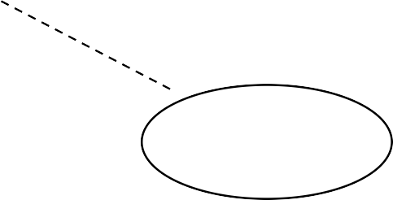





CO Organisational Structure
Sport Organisation
Organising Committee
Advantage
Coordination Role
Enhancement of organizational skills in the territory having
a speciﬁc background in the organization of sport events
Cost Reduction
Contract 3
Contract 1
Contract 2
Sport Association C
Sport Club A
Nat. Sp Fed B
Basket
Soccer
Athletics

Slide 12

Games Centre
Location
The Accreditation Center and the Sponsor Village of the World Masters Games will be organized within the historic “Parco del Valentino” which will also host the Media Centre.
The Sponsor Village will be the heart of the World Masters Games 2013, and will host both the Commercial Area dedicated to the partner / supplier and both the Area Events dedicated to the shows and sporting events.
Accreditation Center and Village will open from 27 July to 11 August, the sports area will be involved by the events starting from August 3.

Slide 13
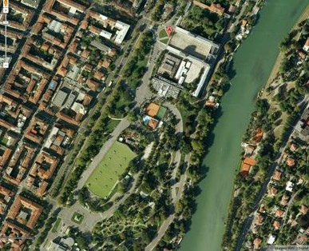








Games Centre
Sponsor Village
Accreditation Center

Slide 14
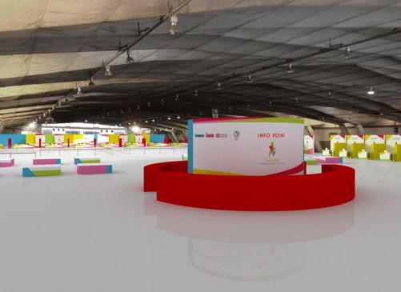

Games Centre
To Expo Pavilion 5

Slide 15
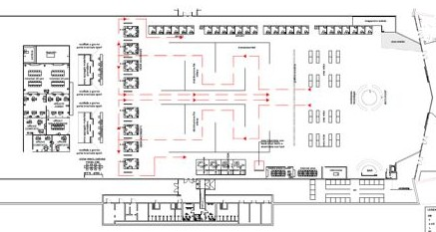
Games Centre
Accreditation - General Layout

Slide 16
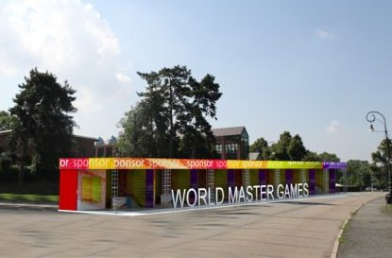

Games Centre
Sponsor Village
The Village of the World Masters Games will primarily be a meeting point for all participants and the city of Turin.
The activities of the Village will be marked by a busy schedule of events that will enliven the Valentino Park for the summer.

Slide 17
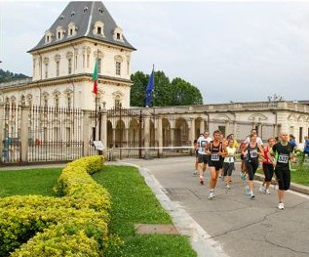












Games Centre
Sport in the
Parco del Valentino
Sport Program |  | 034aug | 044aug | 054aug | 064aug | 074aug | 084aug | 094aug | 104aug | 114aug
 |  | S | S | M | T | W | T | F | S | S
Duathlon | Sprint
Atlhetics | 10 km
Ciclying | Criterium
 | Time Triathlon
Athletics | 10 km Road
Ciclying | Road Race
Athletics | ½ marathon
Triathlon | Sprint
The Area of the Parco del Valentino set up for the competitions will be interested each day with the following program:

Slide 18


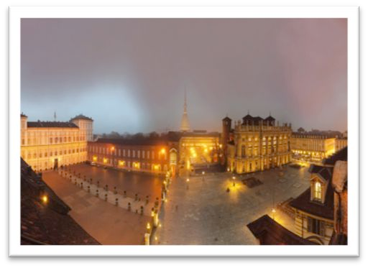
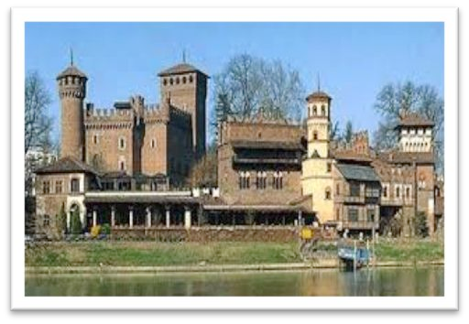
Ceremonies
Opening & Closing
Opening Ceremony will take place on 3 August, 2013 in Torino Piazza Castello.
Size of the Event and entertainment are under definition according to the available funds
Closing Ceremony will take place in the Parco del Valentino on 11 August, 2013

Slide 19
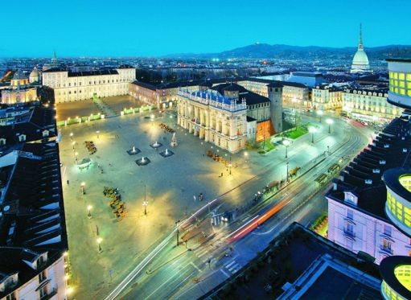


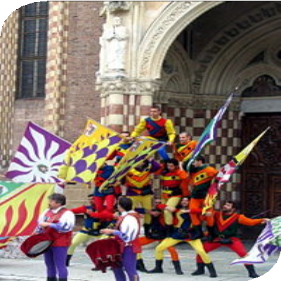


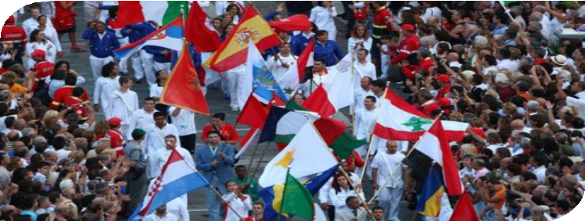
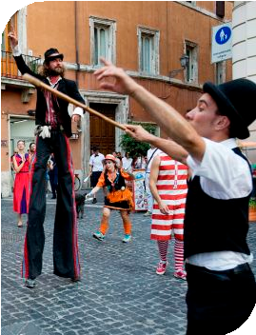

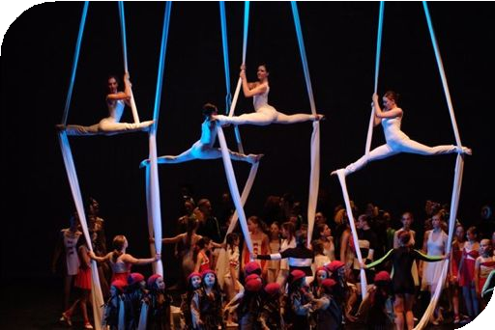
Opening Ceremony
Piazza Castello

Slide 20

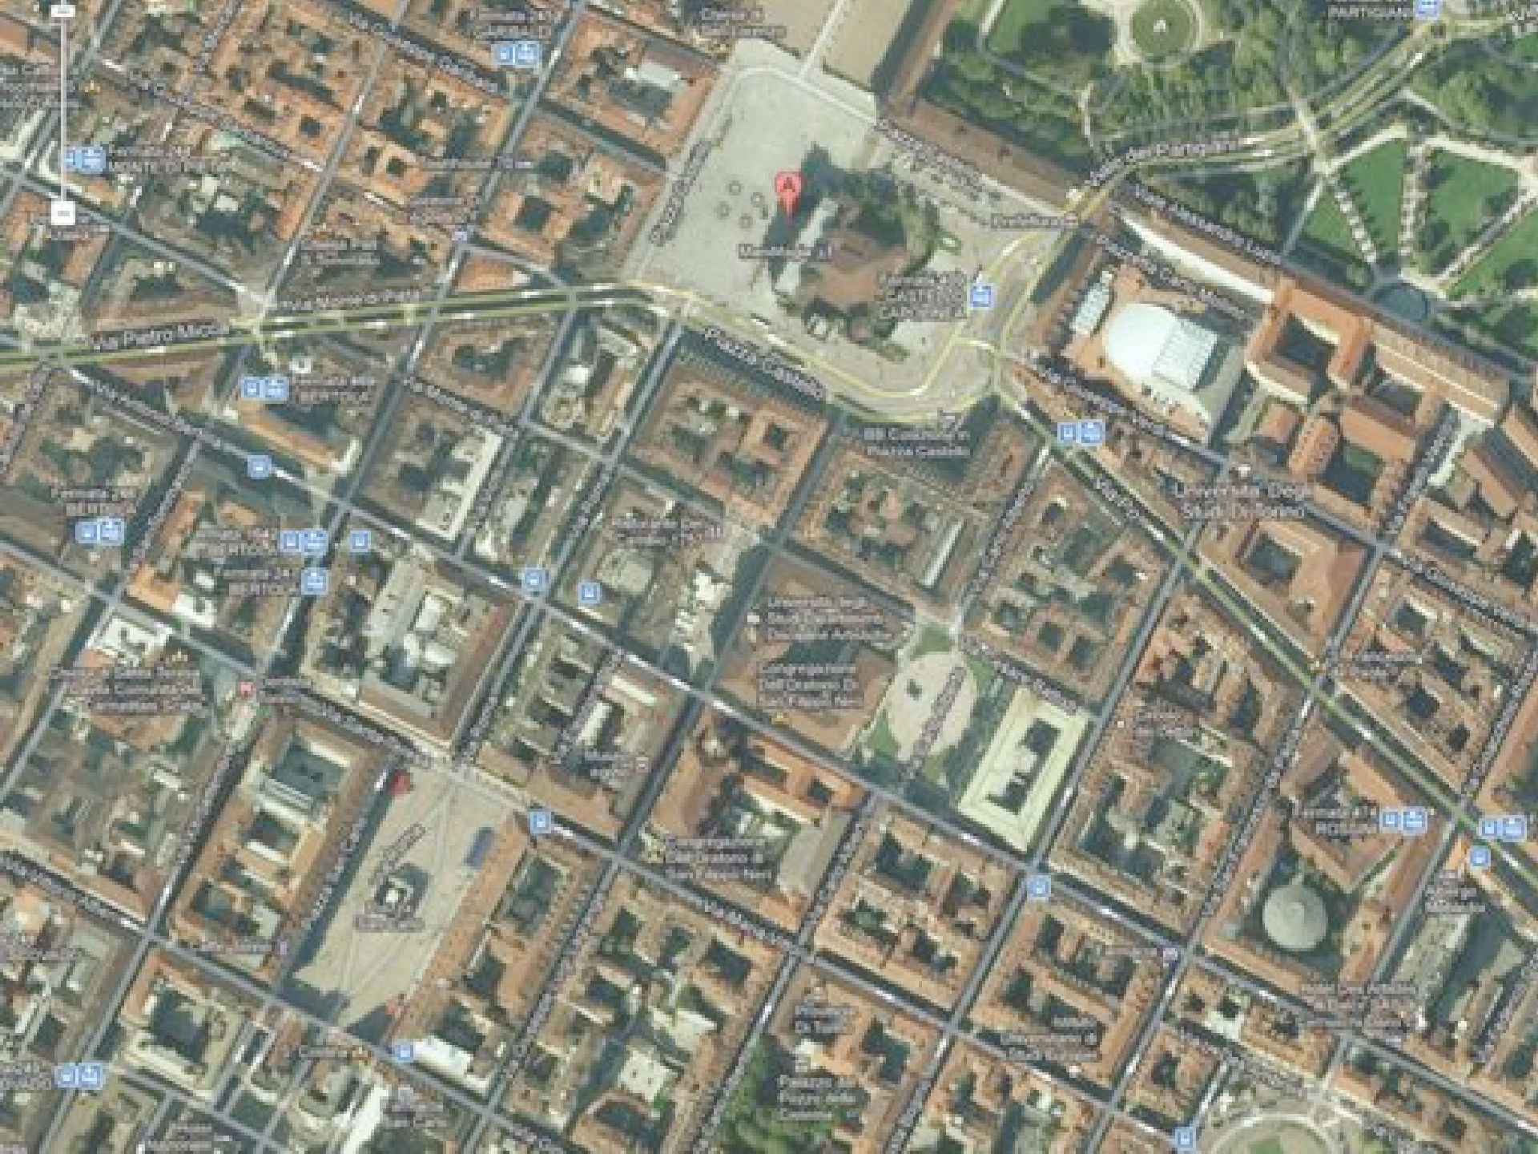




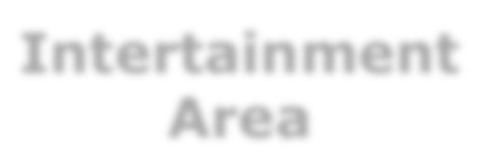














Opening Ceremony
Parade
Intertainment
Area
Athlete’s position
Parade Starting Point - Piazza San Carlo

Slide 21


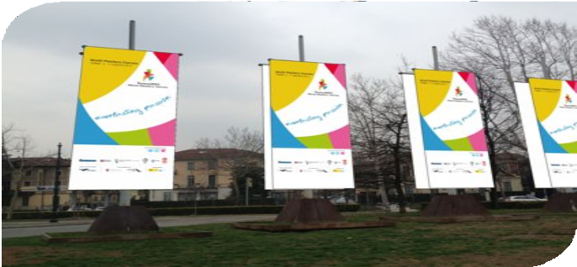

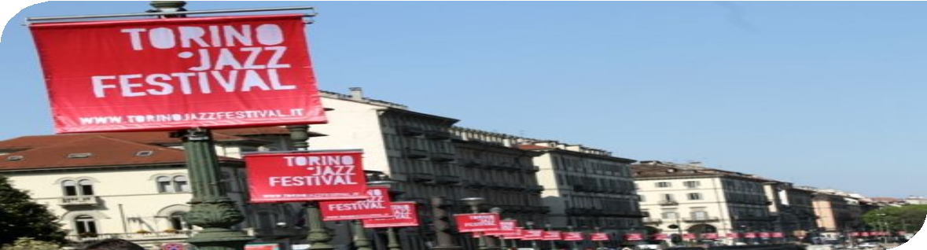





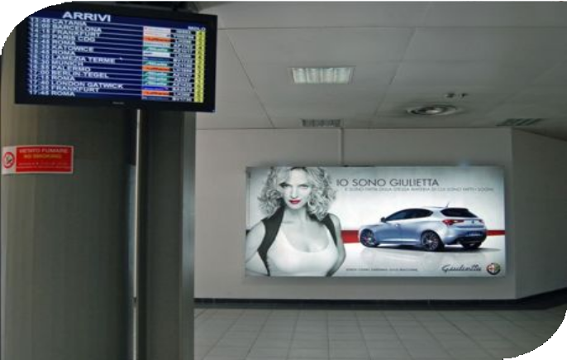





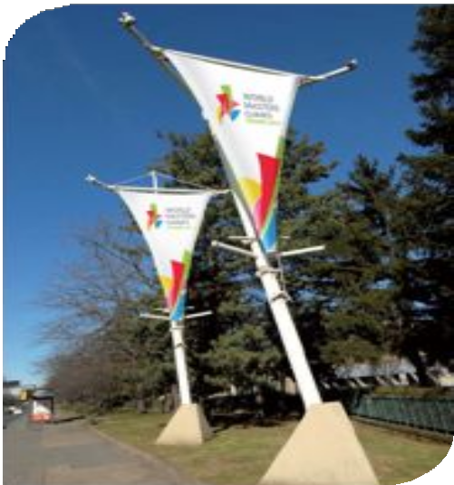



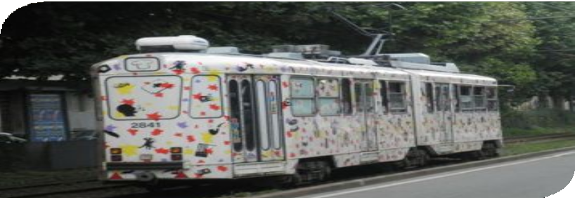
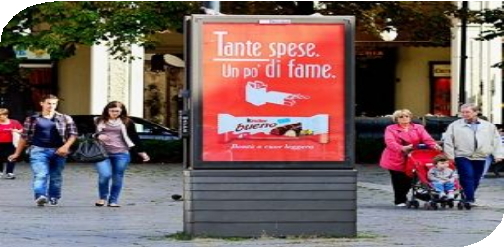

Look of the Games
Look of the City

Slide 22


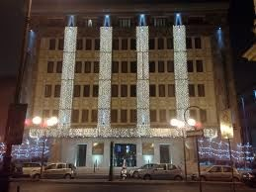

IMGA Family
Hospitality
The IMGA Family will be hosted during the Games in the Golden Palace Hotel located in Torino downtown
Registration for IMGA Family, transfer services, Welcome Desk, will managed by OC Services Provider.

Slide 23

Broadcasting
TV Production
OC and RAI (Italian Public Broadcaster) have signed a contract and agreed on a common strategy based on:
“RAI SPORT +” that will cover in Italy on daily bases the event with competitions highlights
Daily TV highlights will be broadcasted to the Rigtht Holders

Slide 24


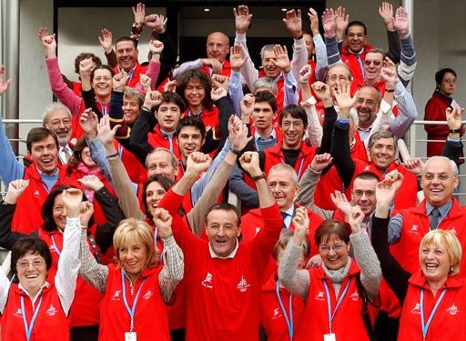
Volunteers
Everlasting Passion
Torino Volunteers believe in the “World Masters Games Torino 2013”, the Organizing Committee will involve them to contribute in the success of the event.
1500 volunteers are planned to be involved in the different operational areas, we are working now in close cooperation with the Volunteers Associations set up during the XX Winter Olympic Games
The participation Form is available on the website

Slide 25
Benefits with Registration
Welcome Bag
Every registered participant will receive a welcome bag with:
WMG Backpack
WMG Technical T-shirt WMG Cap
Free access to 28 Turin’s Museums
Free pass for the Urban public transports during the WMG period “ToBike” service available for the accredited people to use the bike- sharing at the Temporary Station @ Games Center and the other 100 stations scattered in town
Discounts in many shops Gadgets

Slide 26
Games Budget
3,9 Mil
3,9 Mil
" Chamber of Commerce
 | 0,2 Mil | Contingency Sport Organisation Games Services Communication Ceremonies Welcome Bag Medals Accreditation System Medical Services/AD Transport Volunteers Financial &Legal Human Resources |  | 0,100 Mil
 |  |  | 1,3 Mil
 | 1,4 Mil
 |  |  | 2,5 Mil
 | 2,3 Mil
" Registration Fees
" Public Founding
Regione Piemonte
•
0,9 Mil
1.4 Mil
Comune di Torino
Entrance
Expenditure

Slide 27













Sponsors
Top Sponsors

Slide 28
Timeline & Actions up to August 2013
Next Actions
June 12th, Meeting in Rome with the Minister of Sport and NOC Sport program revision
Sport venue contracts finalization
Daily Competition Schedule preparation (after registration deadline) Sport Guide revision
Medal Ceremonies procedure Transport plan revision
Agree upon an Insurance policy
Medical Services and Antidoping plan definition Games Time staff workplan definition Volunteers training development
Look of the Games set up Venues set up

Slide 29


Thank you for your aYention See you in Torino!

