Slide 1
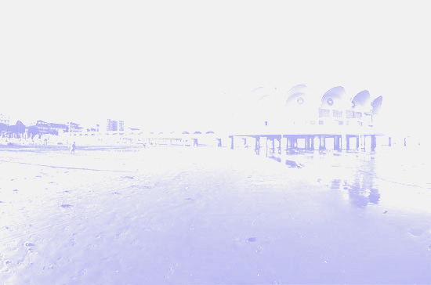
European Masters Games LIGNANO 2011
10th – 20th September
Your Logo

Slide 2
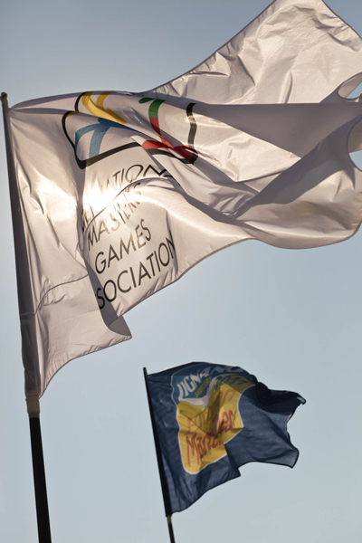
Participants
3,203 athletes
2,167 internationals from 60 countries
440 Russia
349 Ukraine
228 Germany
1,036 Italians
Your Logo

Slide 3
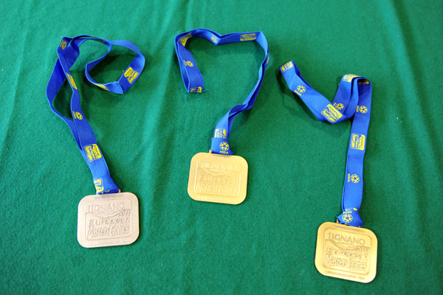
20 sports – 24 venues
5 a-side football
Archery
Athletics
Beach Volley
Canoe-Kayak
Cycling
Dance Sport
Fencing
Golf
Handball
Judo
Karate
Orienteering
Rowing
Sailing
Clay Target Shooting
Taekwondo
Tennis
Triathlon
Weightlifting
Your Logo

Slide 4
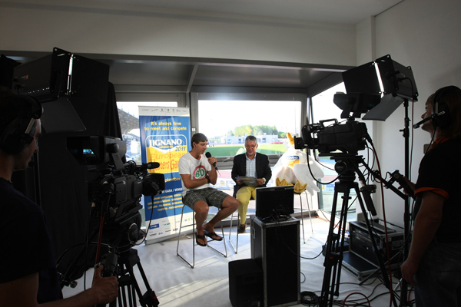
Communications
TV
14 hours of TV production broadcast on
RaiSport
Reports from Lignano 2011 in the sporting
programme Stade 2 and Austria’s Orf
Over 150 hours of recordings and specials broadcast on Friuli Venezia Giulia regional channels
12 hours of live streaming on www.lignano2011.it
Publications
550 articles published at international, national and local levels
On line photo gallery also on Gazzetta.it, Repubblica.it and LaStampa.it
Your Logo

Slide 5
Communications
Social Medias
Use of Facebook, You Tube and Twitter as communication tools were used. The Organizing Committee was able to promote upcoming events and news and provide important information to the athletes.
Facebook was the most successful tool, with more than 1’400 members signing up to the group, where members shared information, photos and footage.
Twitter and You Tube accounts set up for the Games also enabled people to share their comments and footage with others.
Your Logo

Slide 6
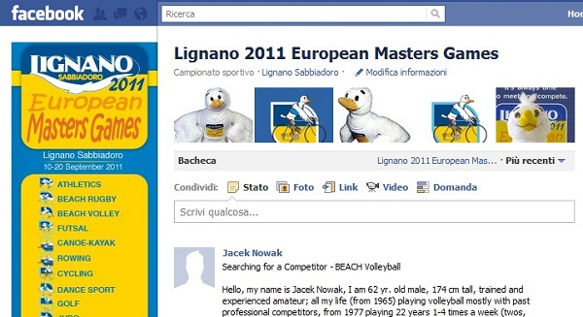
Communications
Social Medias
Your Logo

Slide 7
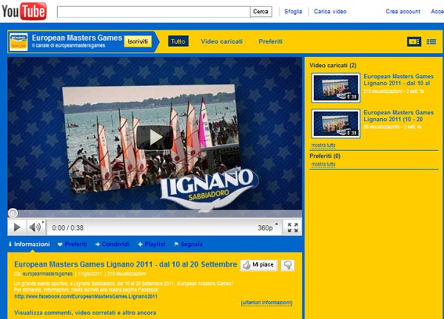
Communications
Social Medias
Your Logo

Slide 8
Budget
Expenses | Revenues
IMGA fee & Candidature EUR 515’732.70 | Regional Contribution EUR 3’110’934.00
Sports & Venues EUR 1’965’000.00 | Contribution City of Lignano EUR 229’000.00
Marketing, Sales & Communications EUR 653’455.70 | Registrations EUR 400’000.00
Games Services EUR 765’745.70 | Sponsors EUR 15’000.00
Other EUR 35’000.00 | Merchandising EUR 10’000.00
 | Tourism Contribution EUR 120’000.00
 | Other EUR 50’000.00
Total Expenses EUR 3’934’934.00 | Total Revenues EUR 3’934’934.00
Your Logo

Slide 9
Economic Impact
Increase of 33% on arrivals => 6’000 people more for that period of the year
Increase of 24% of hotel nights => 12’000 to 15’000
Increase of 75% in campings
Increase of 90% in appartment rents
45% of nights were in hotels, 35% of nights were in appartments and 20% of nights were in campings
Increase of 45% of foreigners
Increase of 10% of Italians
In total, the Games generated approximatively EUR 4'196'264 for the Friuli Venezia Giulia economy
Visitors stayed in Lignano 6 nights
Your Logo

